Slide 1

Capstone Project Report On
“TRAVEL APPROVAL APP”
BY:
Name: HEMA KUMAR UNDRAJAVARAPU
Batch WIP-SF-13
LMS Id: MGSA_525

Slide 2

CONTENTS
• INTRODUCTION TO SALESFORCE
• INTRODUCTION OF TRAVEL APPROVAL APP
• MODULE 1
• MODULE 2
• MODULE 3
• CONCLUSION

Slide 3

INTRODUCTION TO SALESFORCE
• What is salesforce?
• Why do we use salesforce?
• What does Salesforce do?
• What are the benefits of Salesforce ?
• What is CRM
• What is Cloud Computing

Slide 4
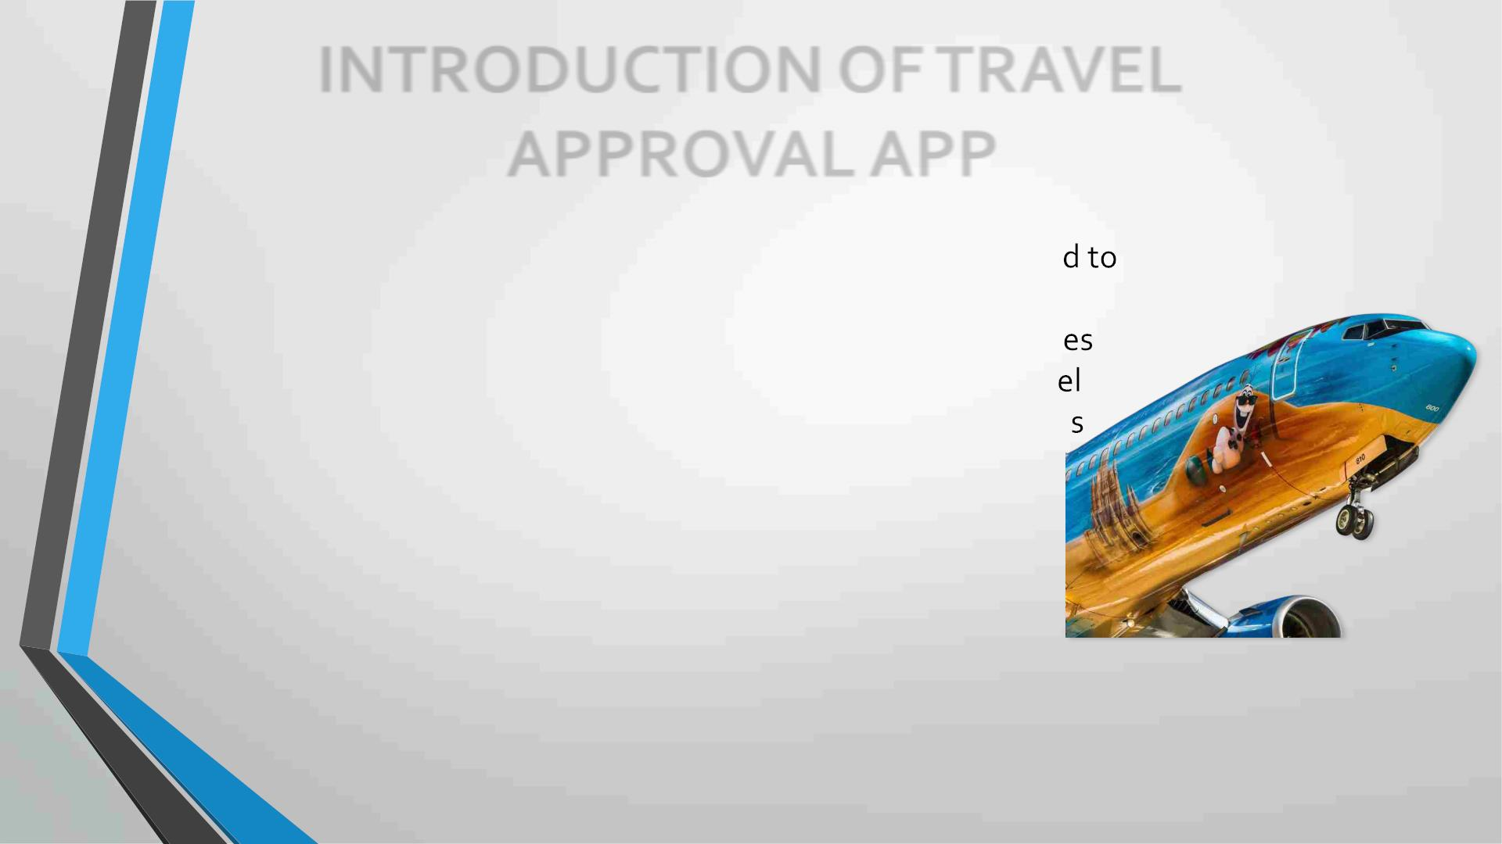
INTRODUCTION OF TRAVEL
APPROVAL APP
• The travel approval project in Salesforce is a system designe
automate and streamline the process of requesting and
approving travel expenses for employees. The project involv
several components, including a custom object to track trav
requests, a custom approval process, and various integration
with external systems.
• Overall, the travel approval project in Salesforce provides a
streamlined and efficient way for employees to request and
manage travel expenses, while also providing managers with the
tools they need to ensure that all expenses are approved and
accounted for.

Slide 5

MODULE 1
• This project module focuses on the non-coding approach to modifying
the user interface, as you customize an app that tracks company travel.
• Create Custom
App, Objects, Fields & Relationships, and how you customize the App
using
declarative tools.
Module Take Away

Slide 6
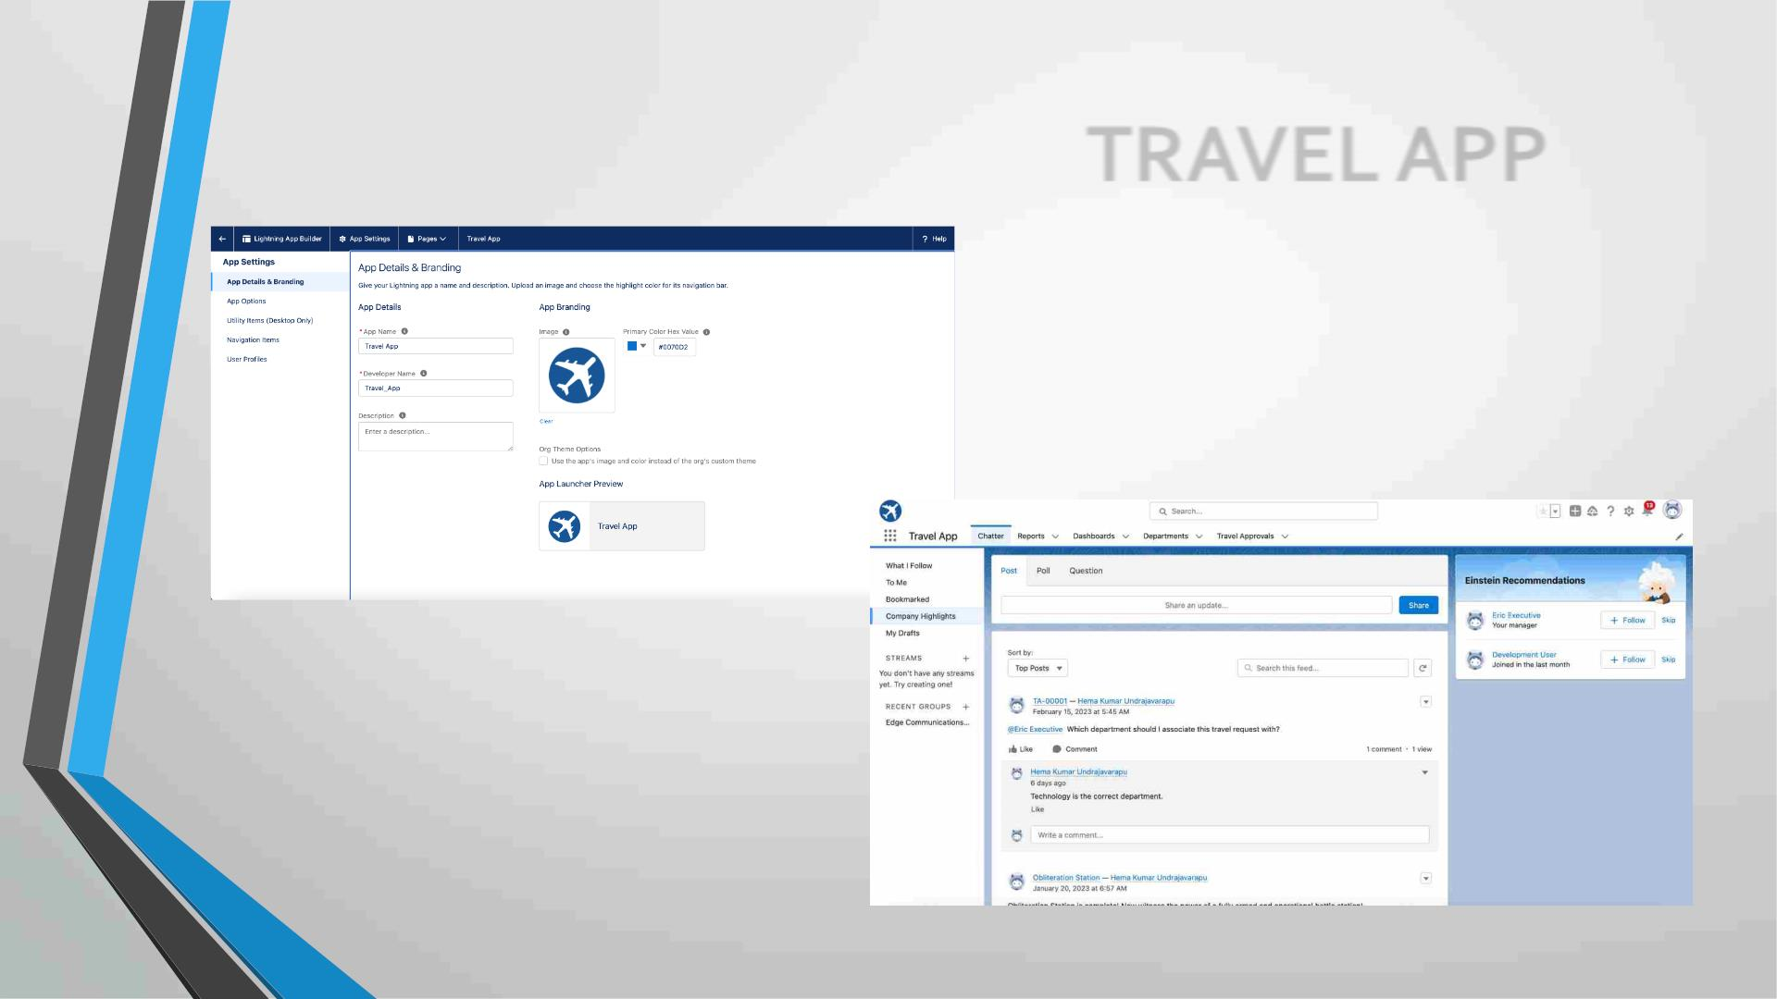
Creating Lightning App: TRAVEL APP

Slide 7
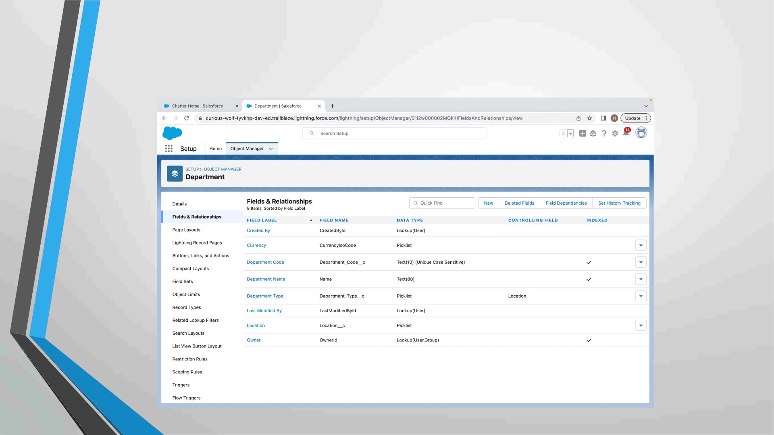
Custom object Department and Creating custom fields in Department
Object

Slide 8
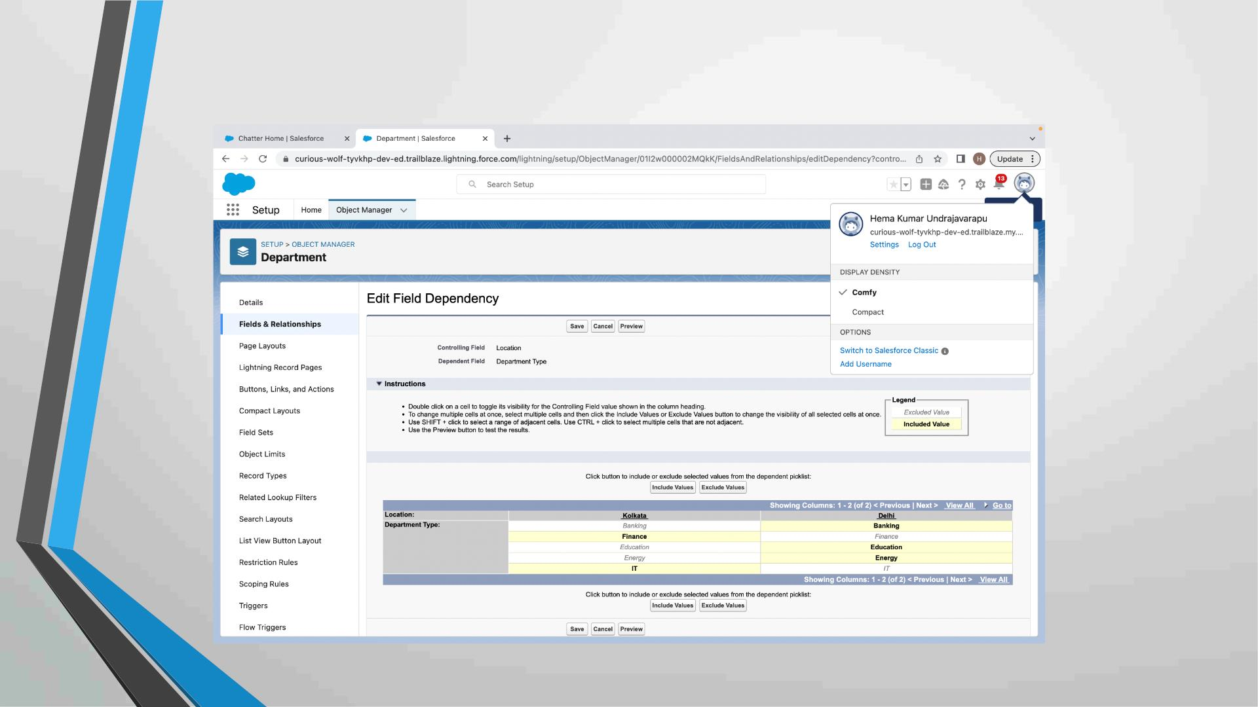
Field Dependency in Department

Slide 9
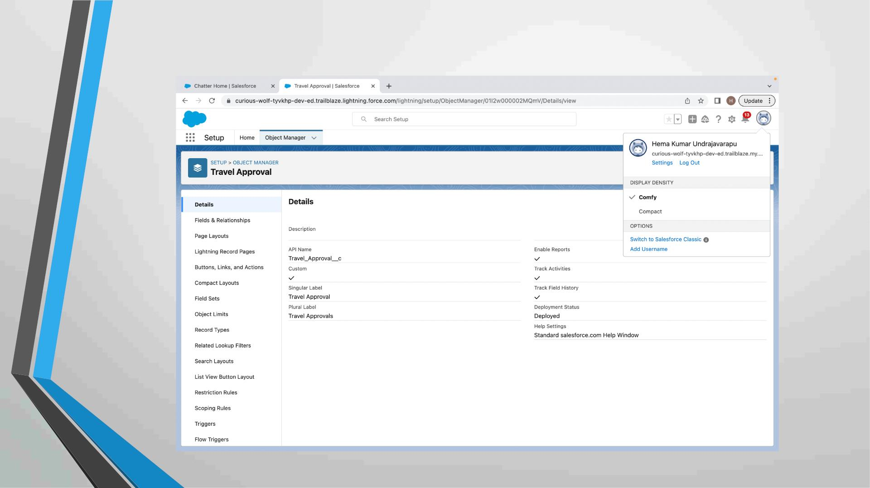
Creating Custom Object Travel Approval and Custom Fields in that
Object

Slide 10
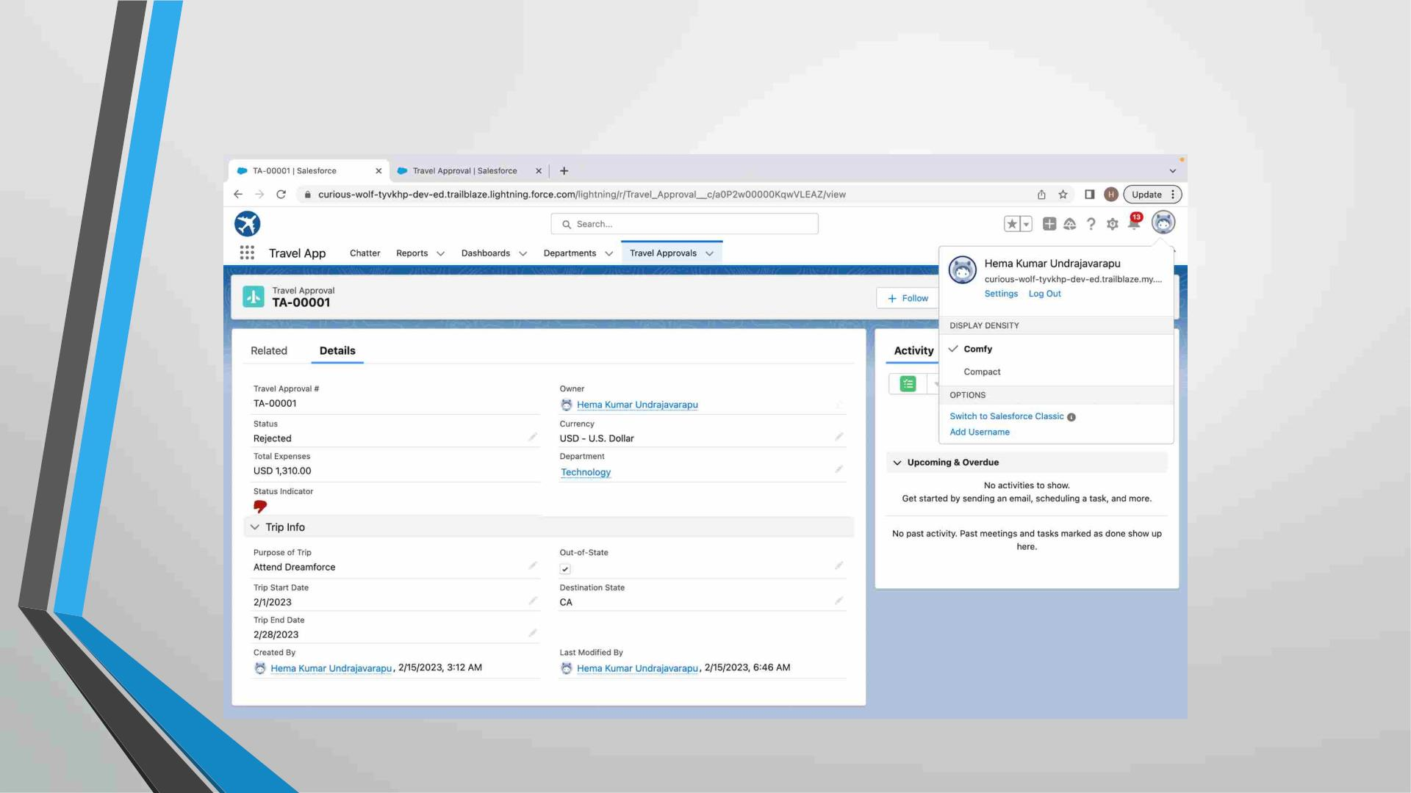
After creating Travel Approval object with fields,
it looks as shown below

Slide 11
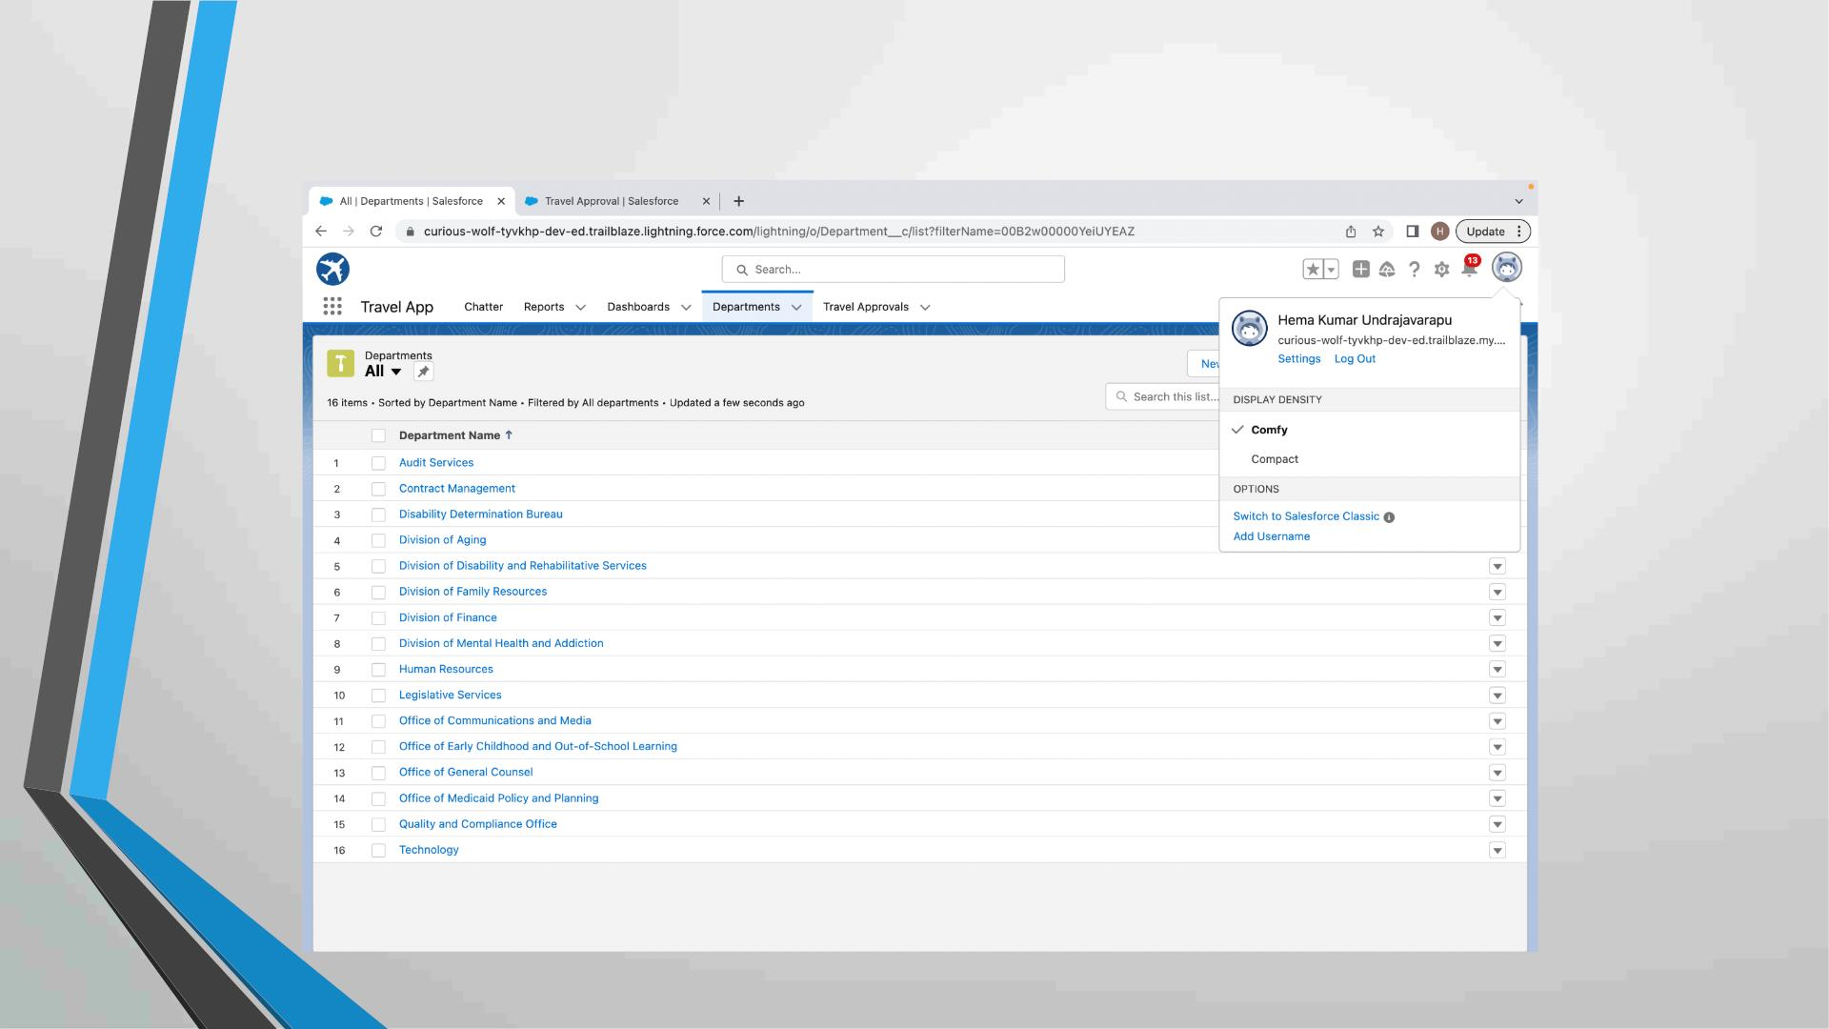
Importing Department records using data import wizard and
imported record data status can viewed below

Slide 12
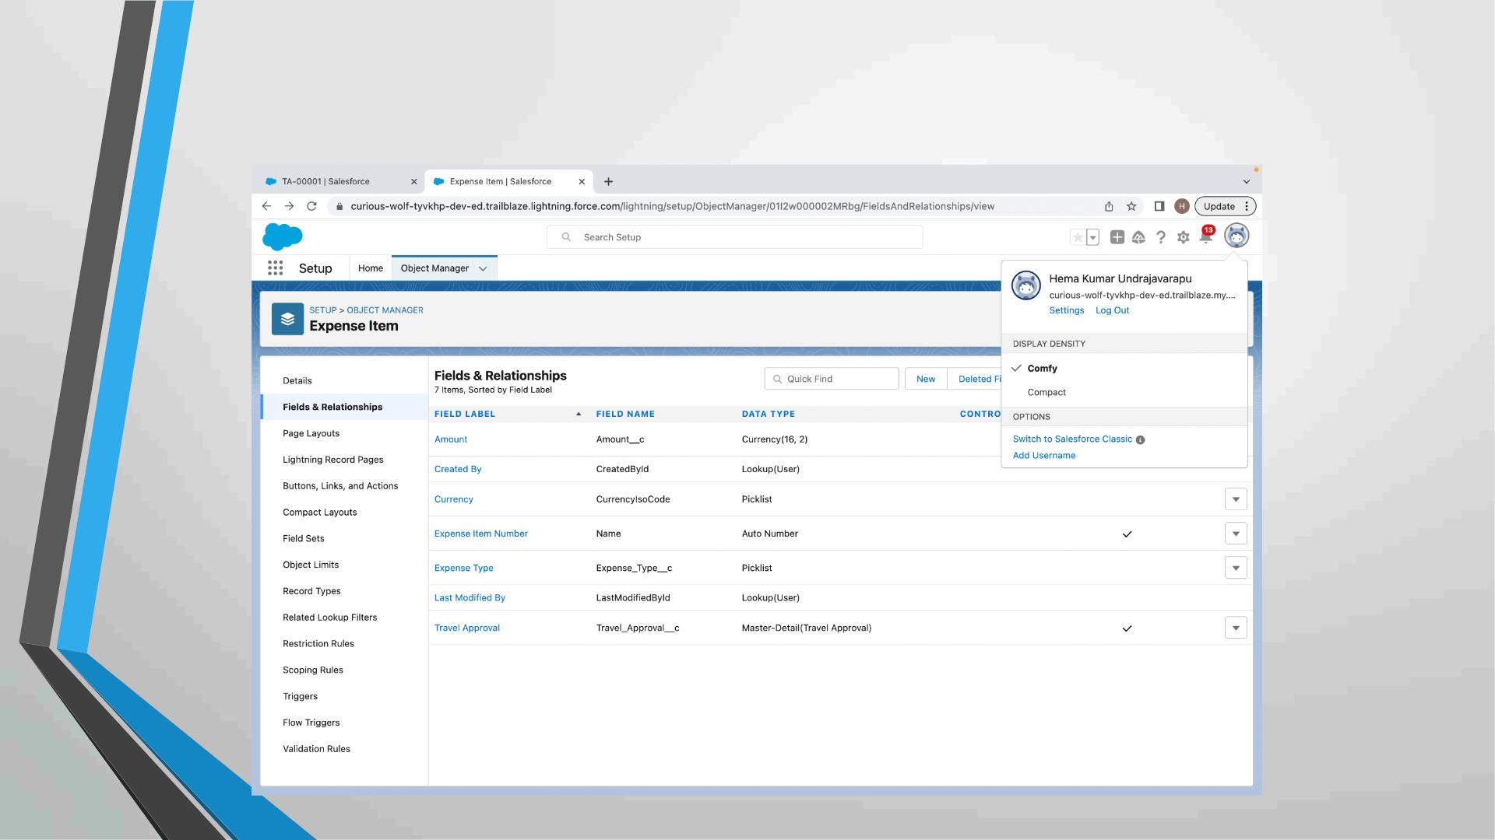
Creating Expense Item custom object and
Custom fields in Expense Item object

Slide 13
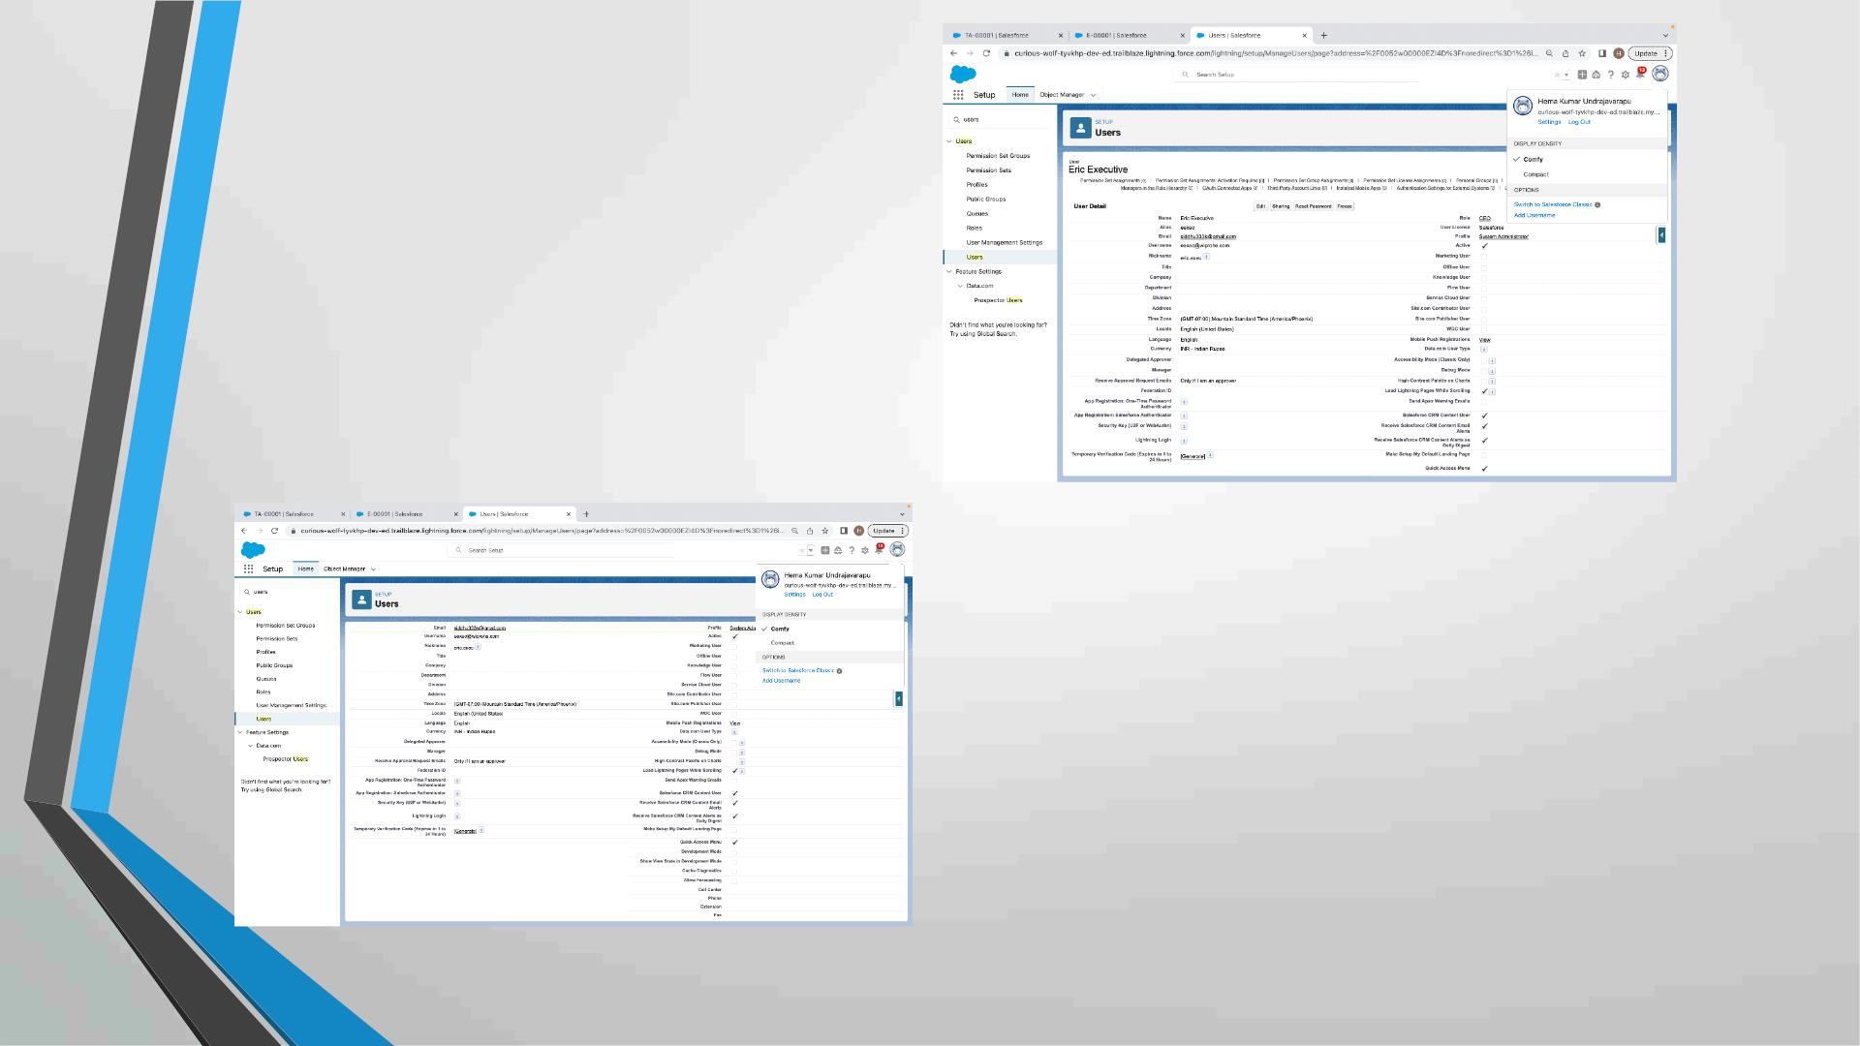
Creating User with
system admin license
Add user eric as
manager own account user

Slide 14
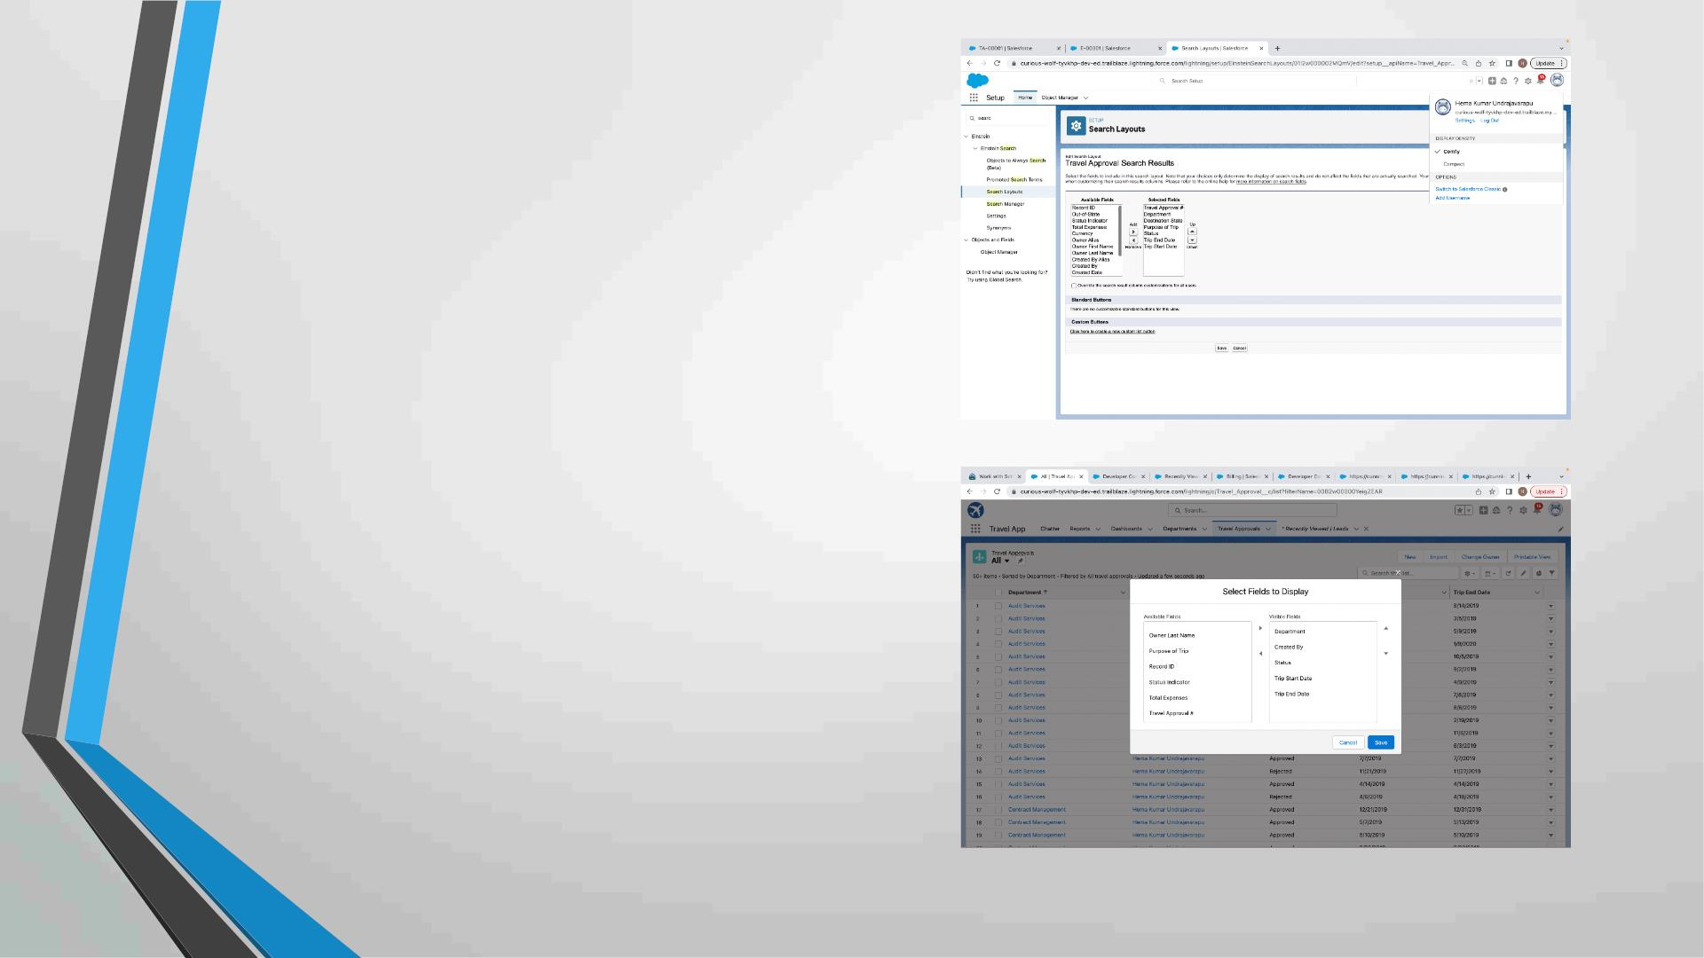
Customize the Travel Approval
Default search layout
Select fields to display in the Travel
Approval “All” List view

Slide 15
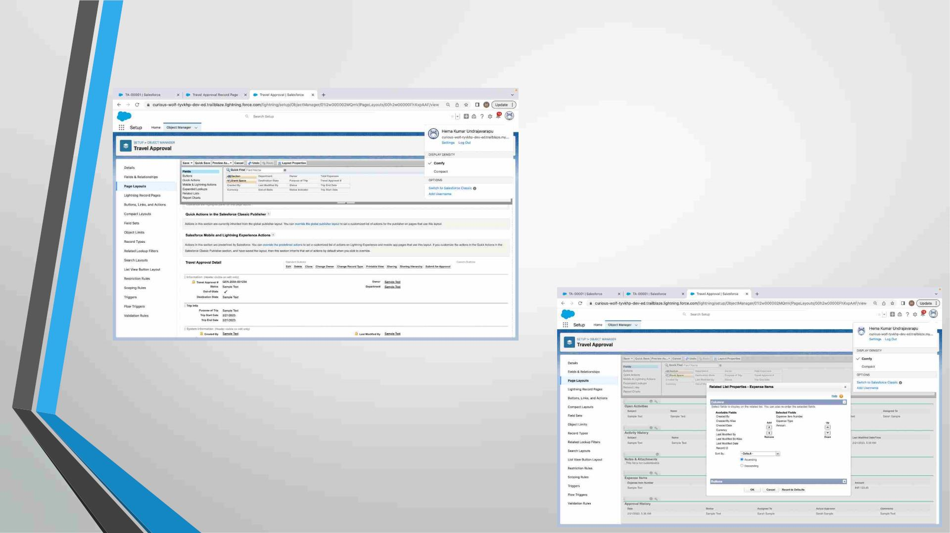
Customizing page layout

Slide 16
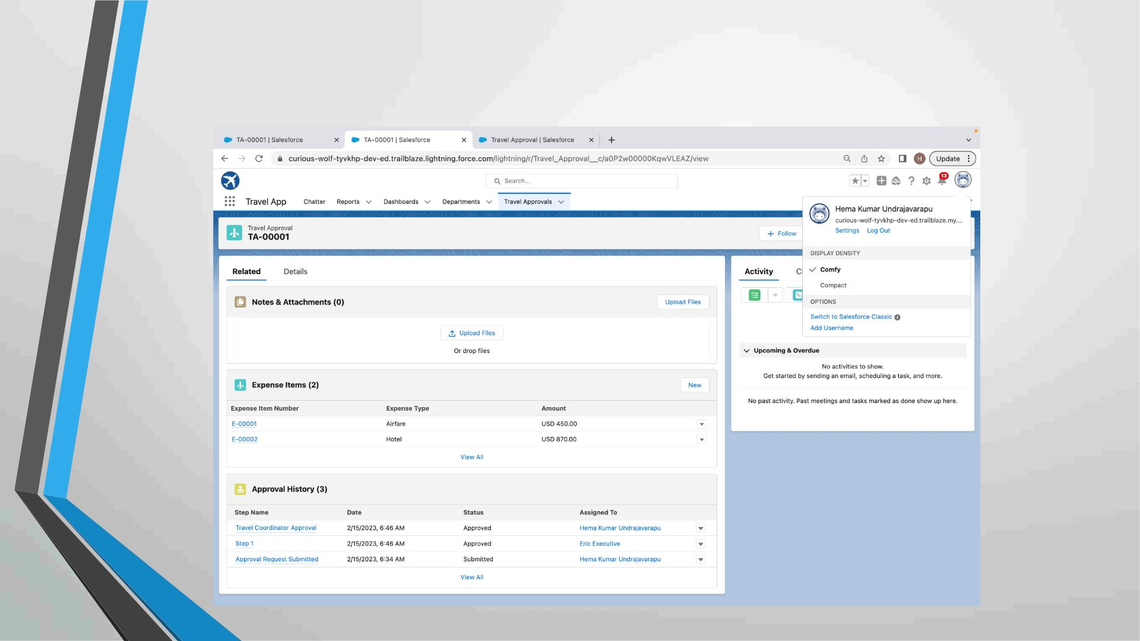
Test the app:

Slide 17
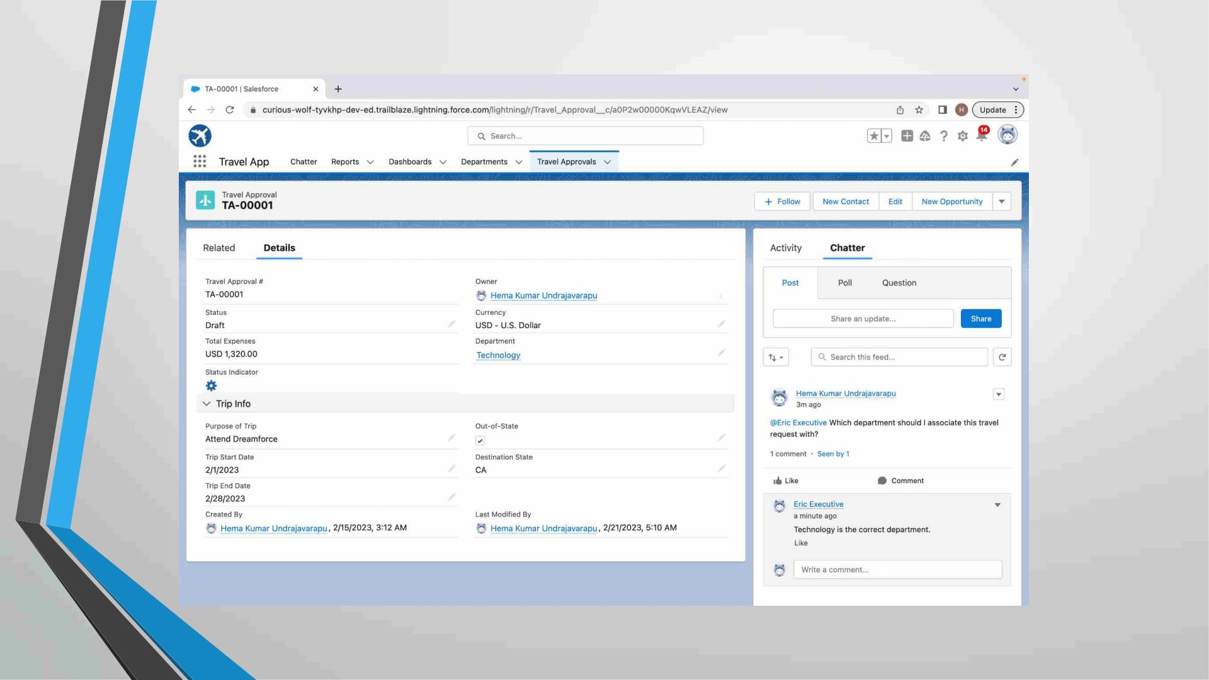

Slide 18

MODULE 2
• This project module focuses on the Automation and Analytics Tools
to enhance your custom App development.
• Define Business logic using Validation rules, Roll-up summary
fields, Formulas, Flows & how you track Travel Approvals using
Reports and Dashboards

Slide 19
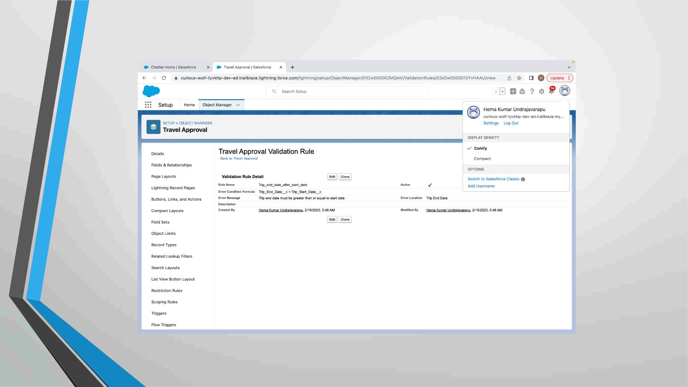
Validation Rule that trip end date always >= start date

Slide 20
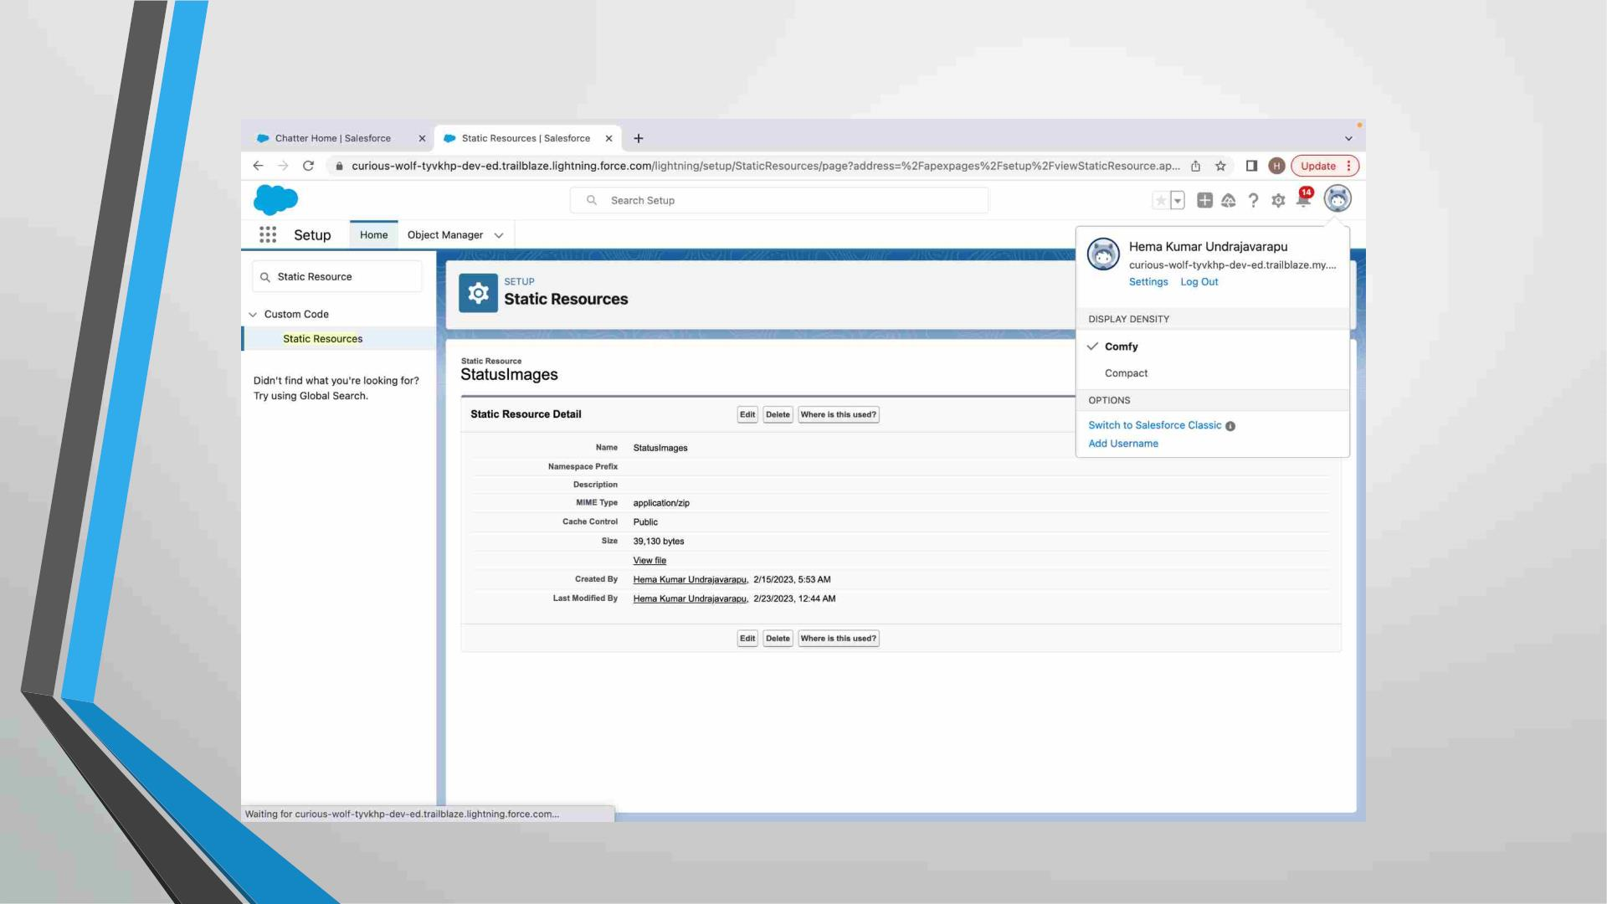
Creating Formula Fields

Slide 21
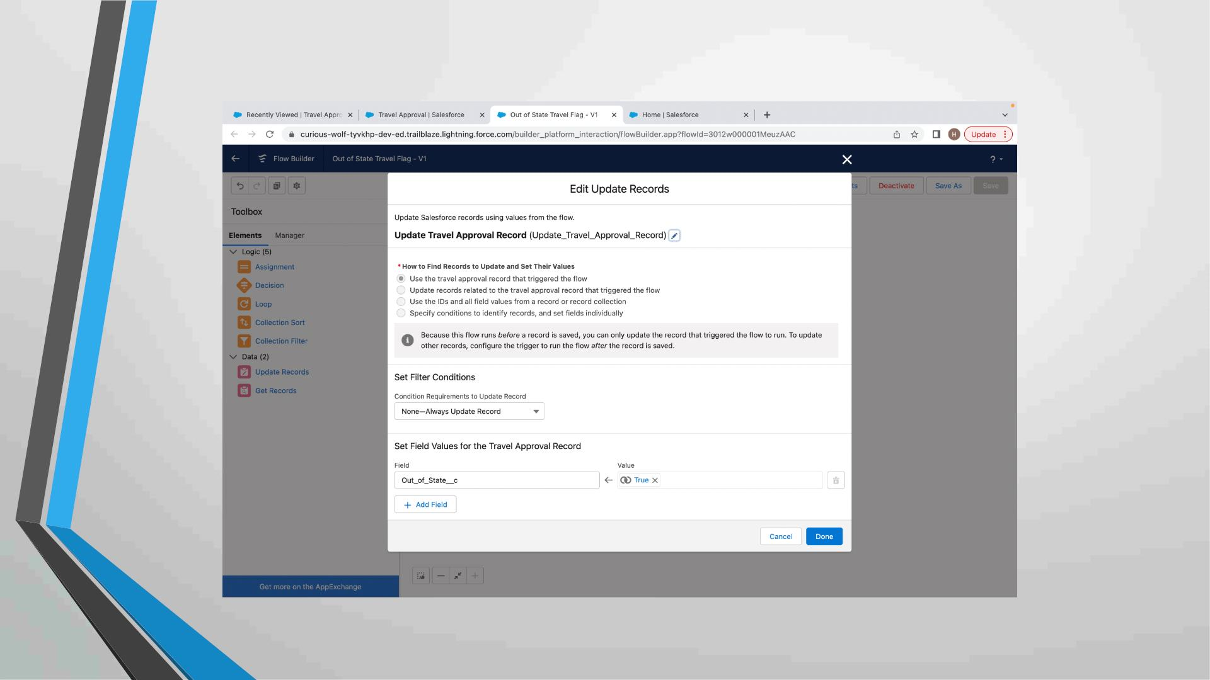
Create a Record – Triggered Flow

Slide 22
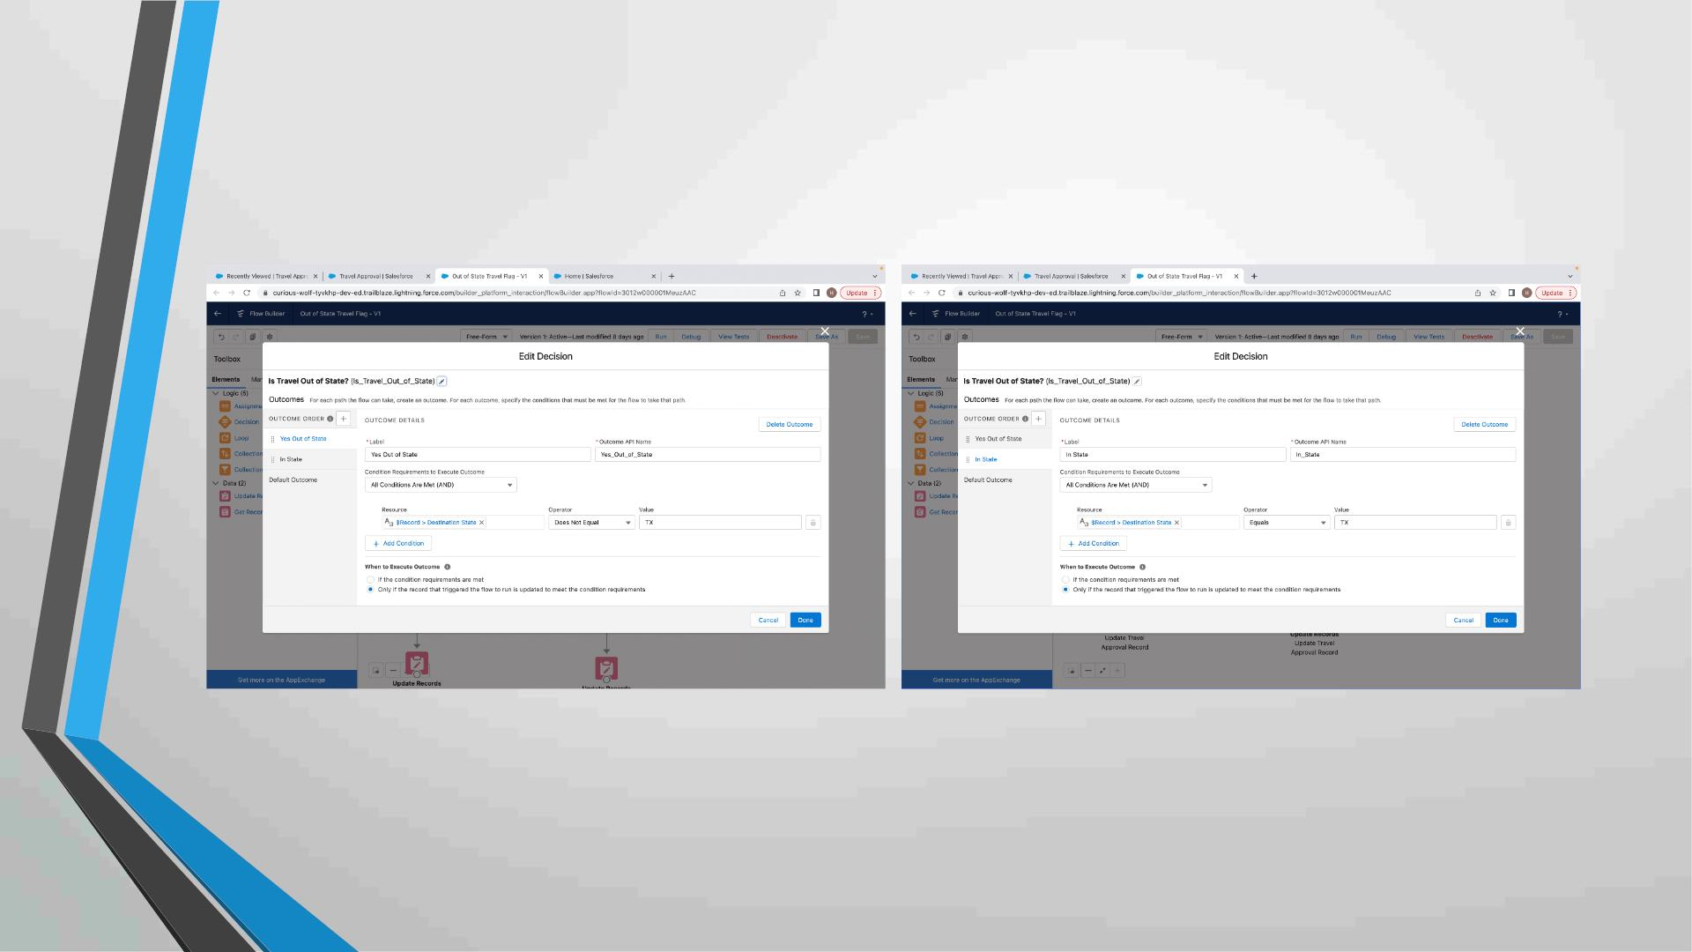
And add Decision element to flow

Slide 23
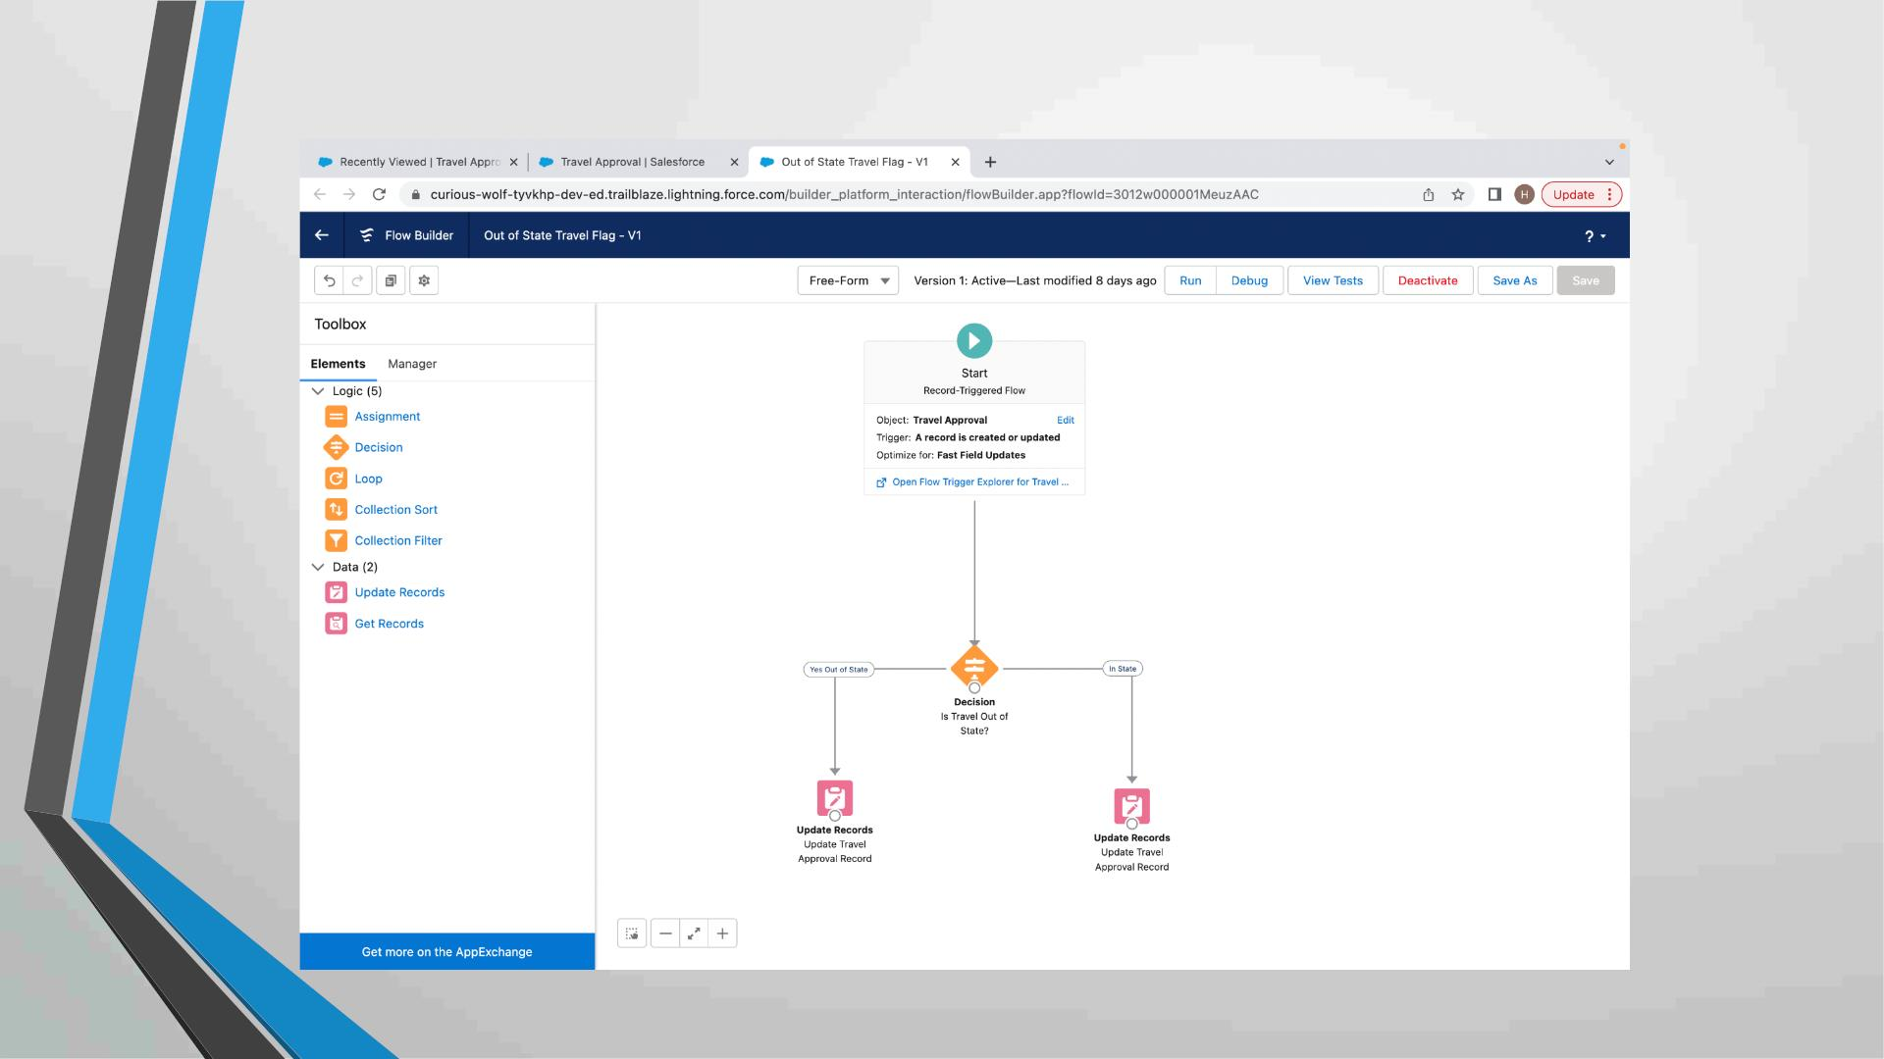
Finally, the flow looks as shown, save and activate

Slide 24
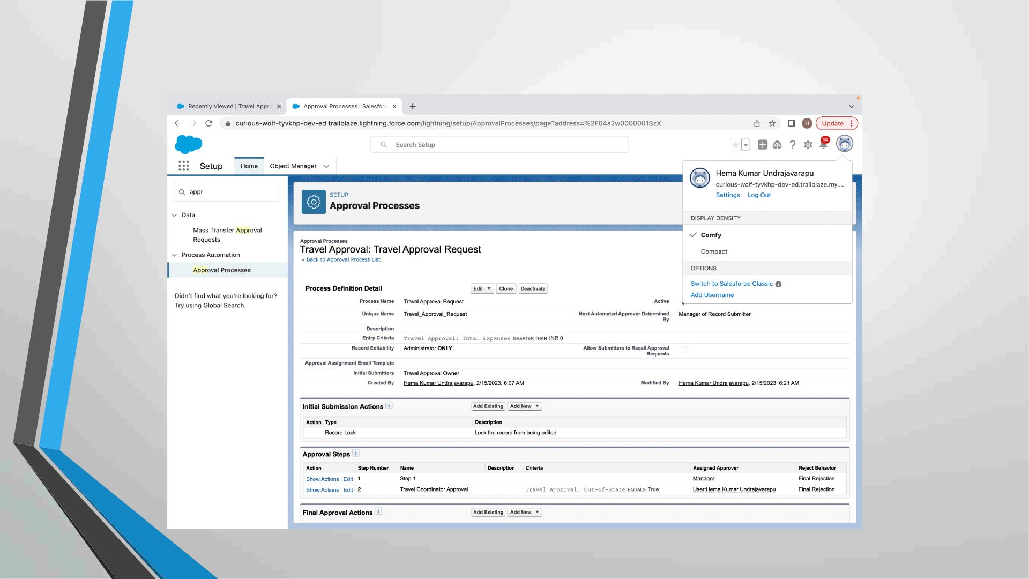
Creating an Approval Process to send travel approvals
to manager or travel coordinator

Slide 25
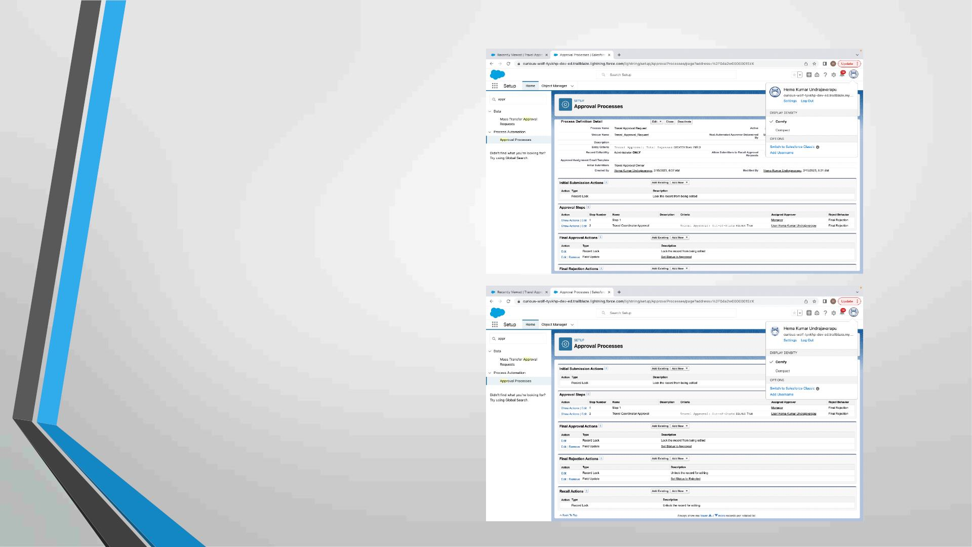
Final Approval Action:
Final Rejection Action:

Slide 26
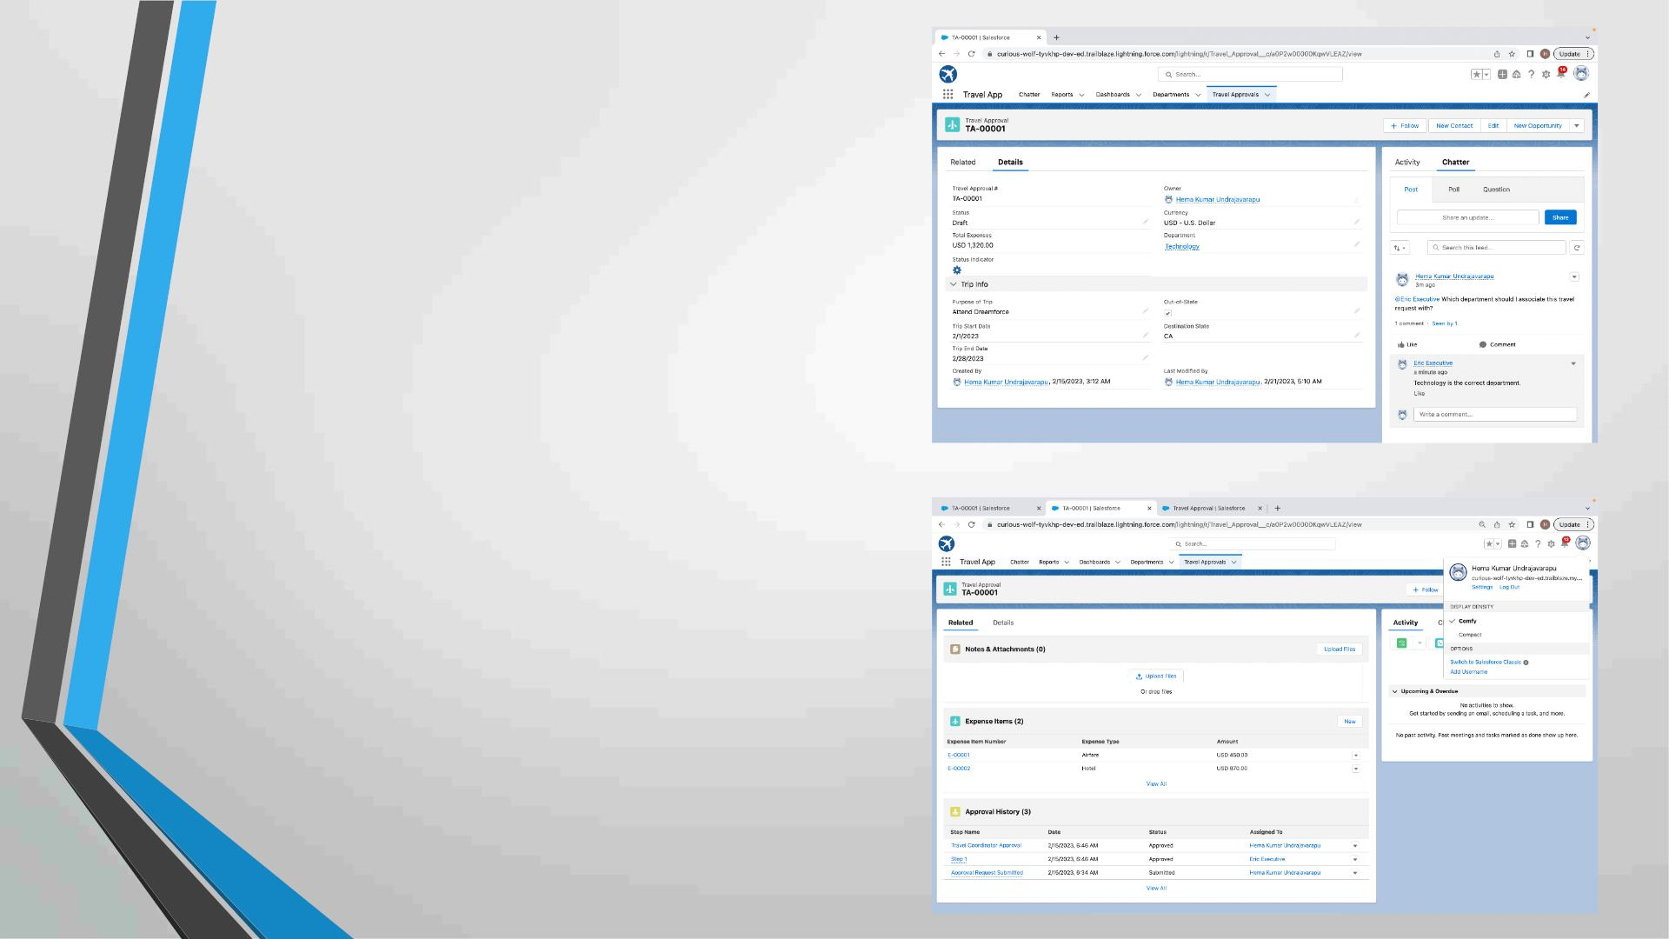
Testing the approval process Status is
pending here, Next submit for
approval
Login as Eric to give Approval
Can Approve or Reject

Slide 27
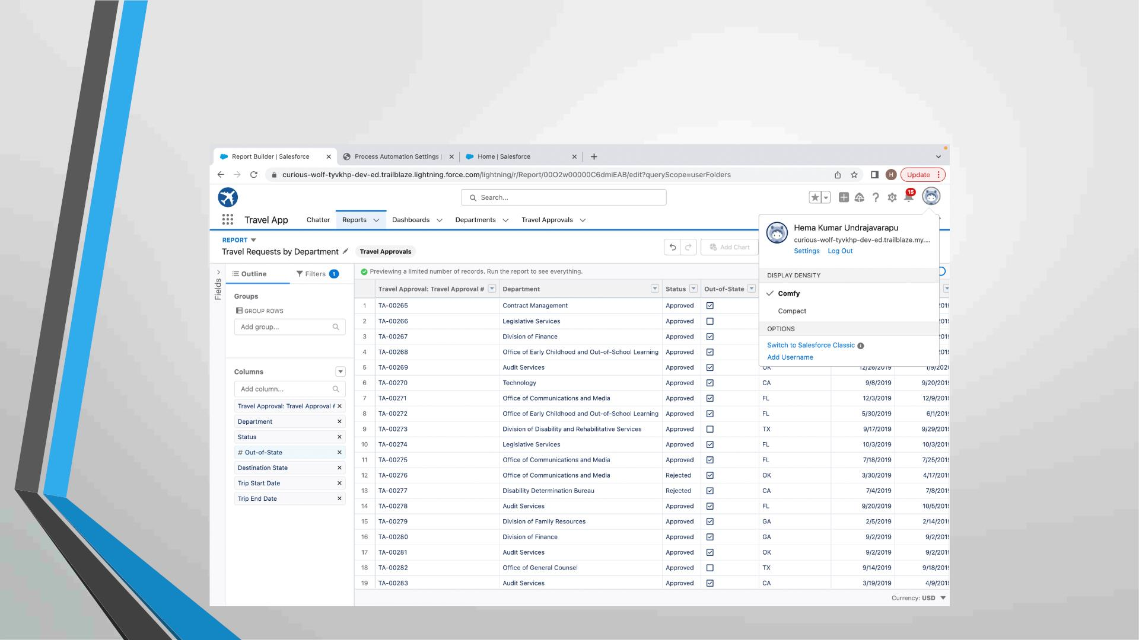
Using Data import wizard to import travel approval records ,
later the Records imported successfully

Slide 28
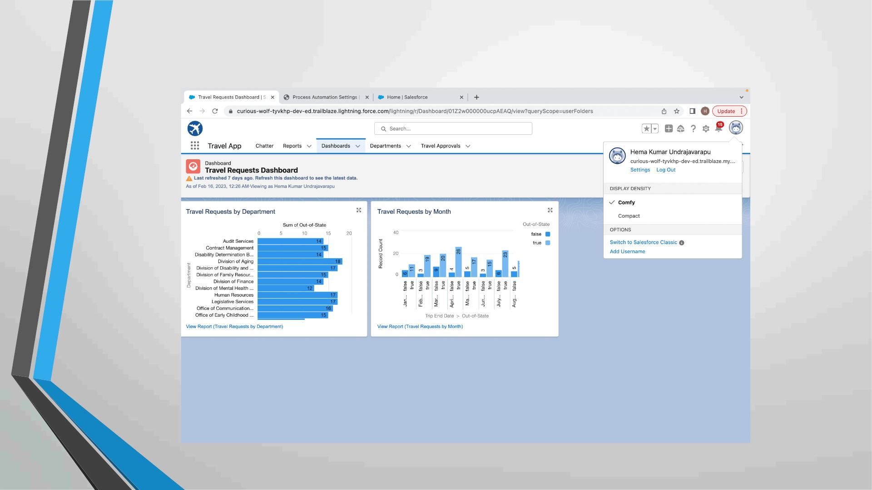
Final Dashboard

Slide 29

MODULE 3
• This project module focuses on the coding approach to extend the
functional capabilities of your custom App.

Slide 30
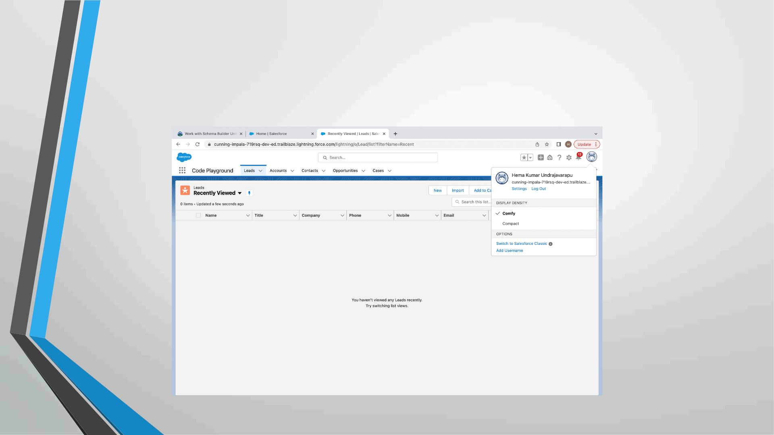
Exercise - 01
Creating Code Playground Lightning App with Lead, Account, Contact,
Opportunity, Case to navigation profile as system admin.

Slide 31
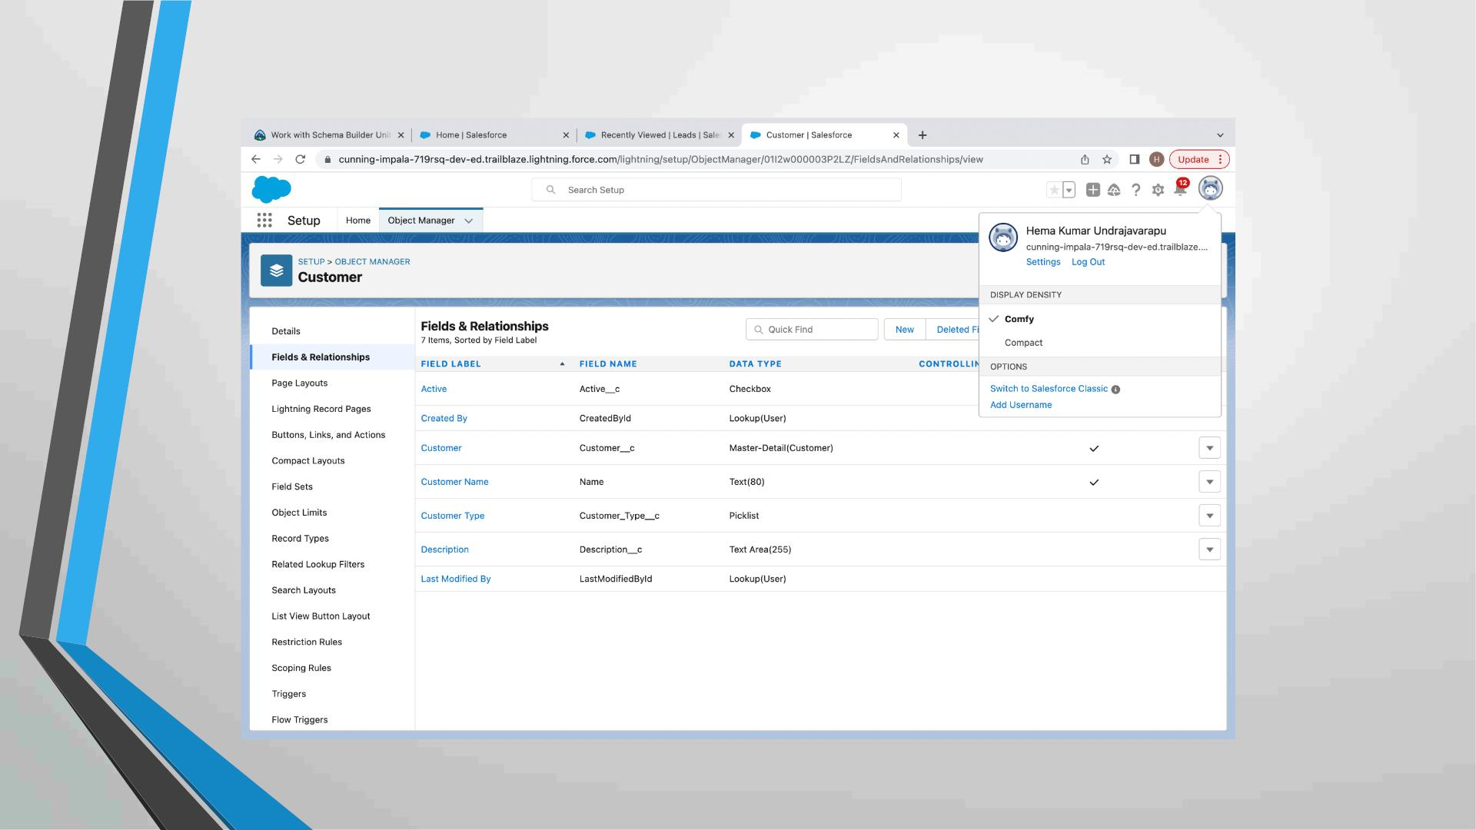
Creating custom object Customer and add related fields

Slide 32
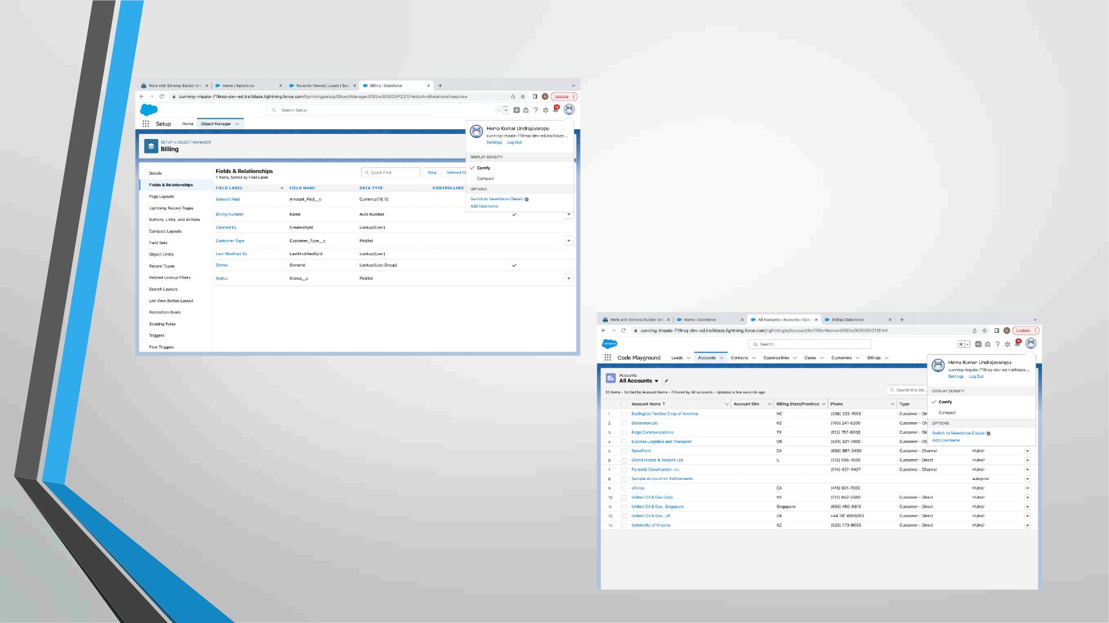
Creating custom object Billing and add related fields

Slide 33
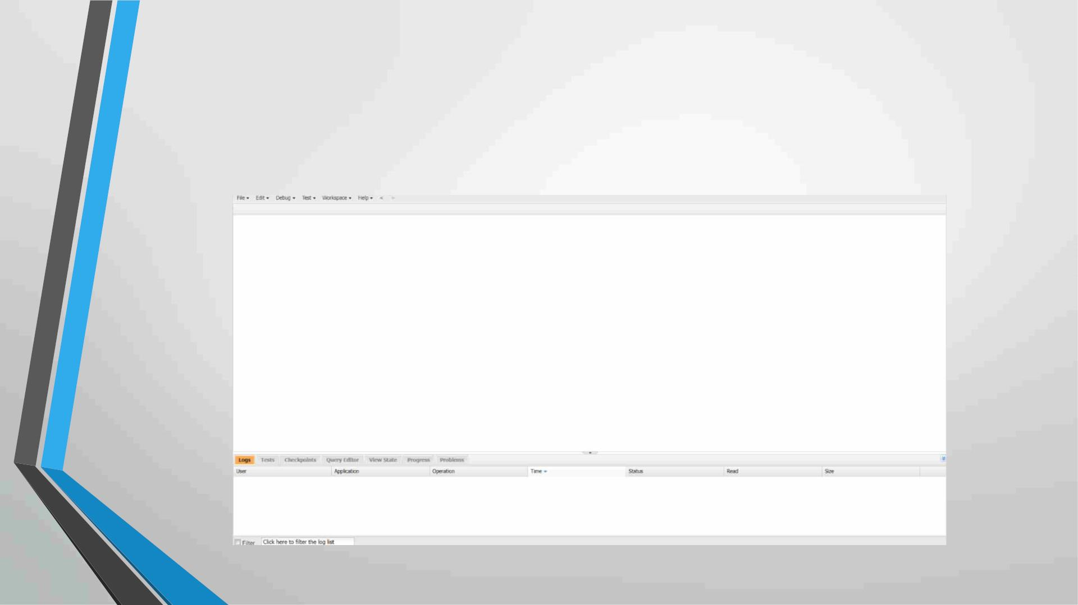
Exercise - 02
Use Execute Anonymous to define and execute the following code:
Developer Console

Slide 34
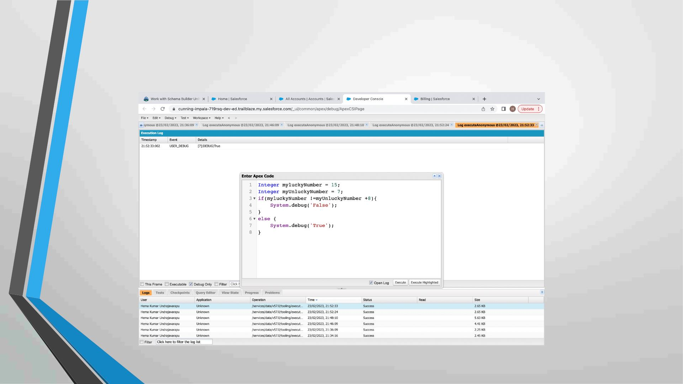
1.Define a String Variable & use string method ‘endsWith’ to display the
output. By clicking oh Debug and select open Anonymous window

Slide 35
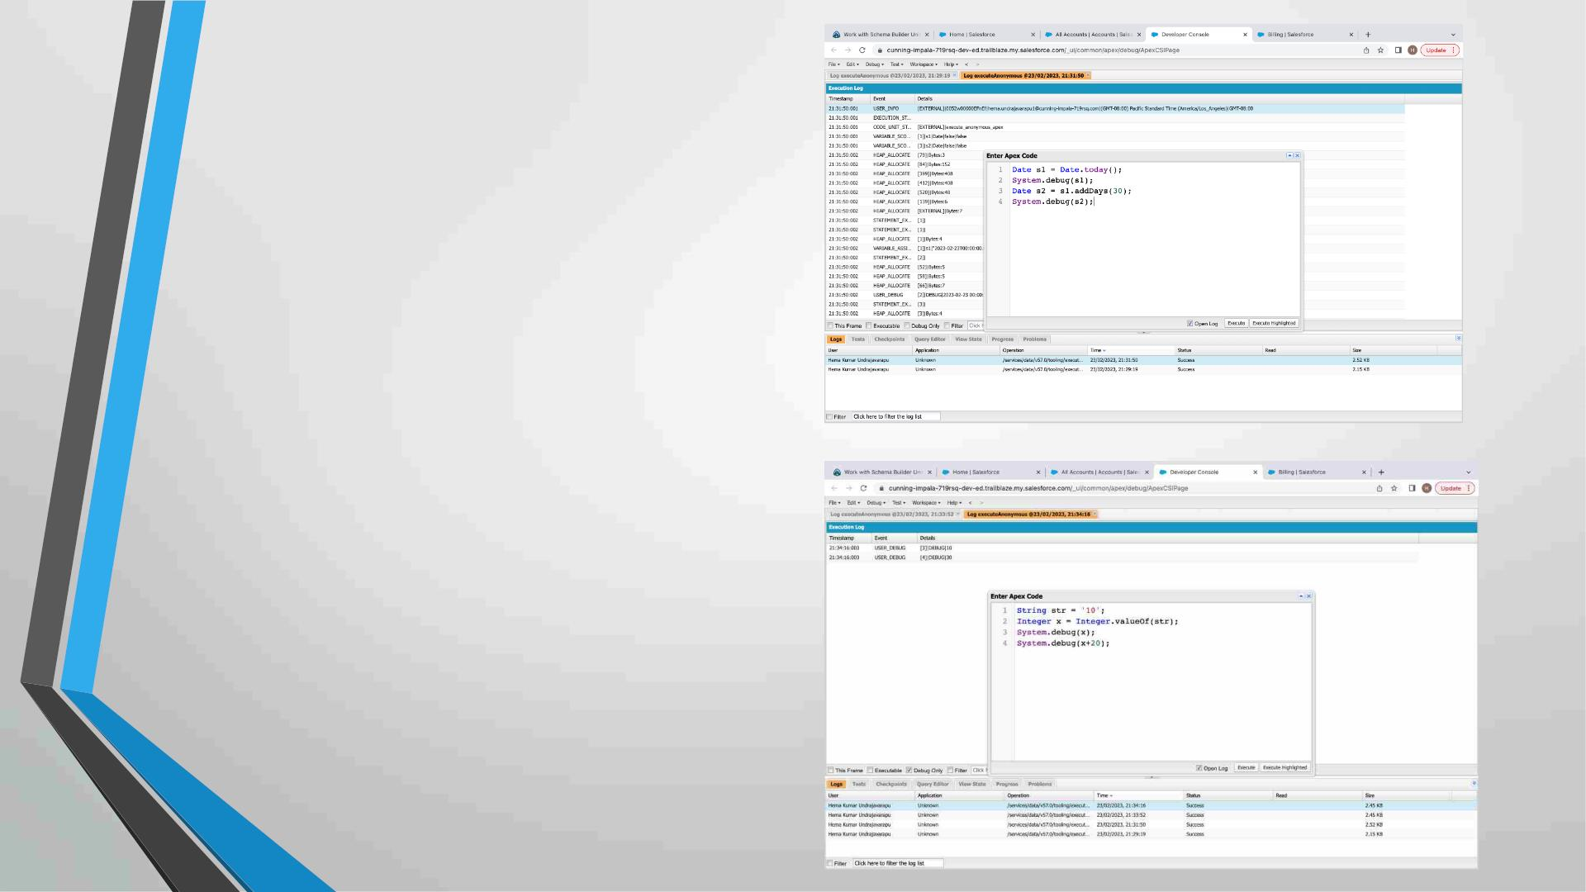
2. Define 2 Date type variables, use
Date method today() & addDays(30)
to display the output
3. Display the output of an Integer
variable from string ‘10’ and then
add 20 to it.

Slide 36
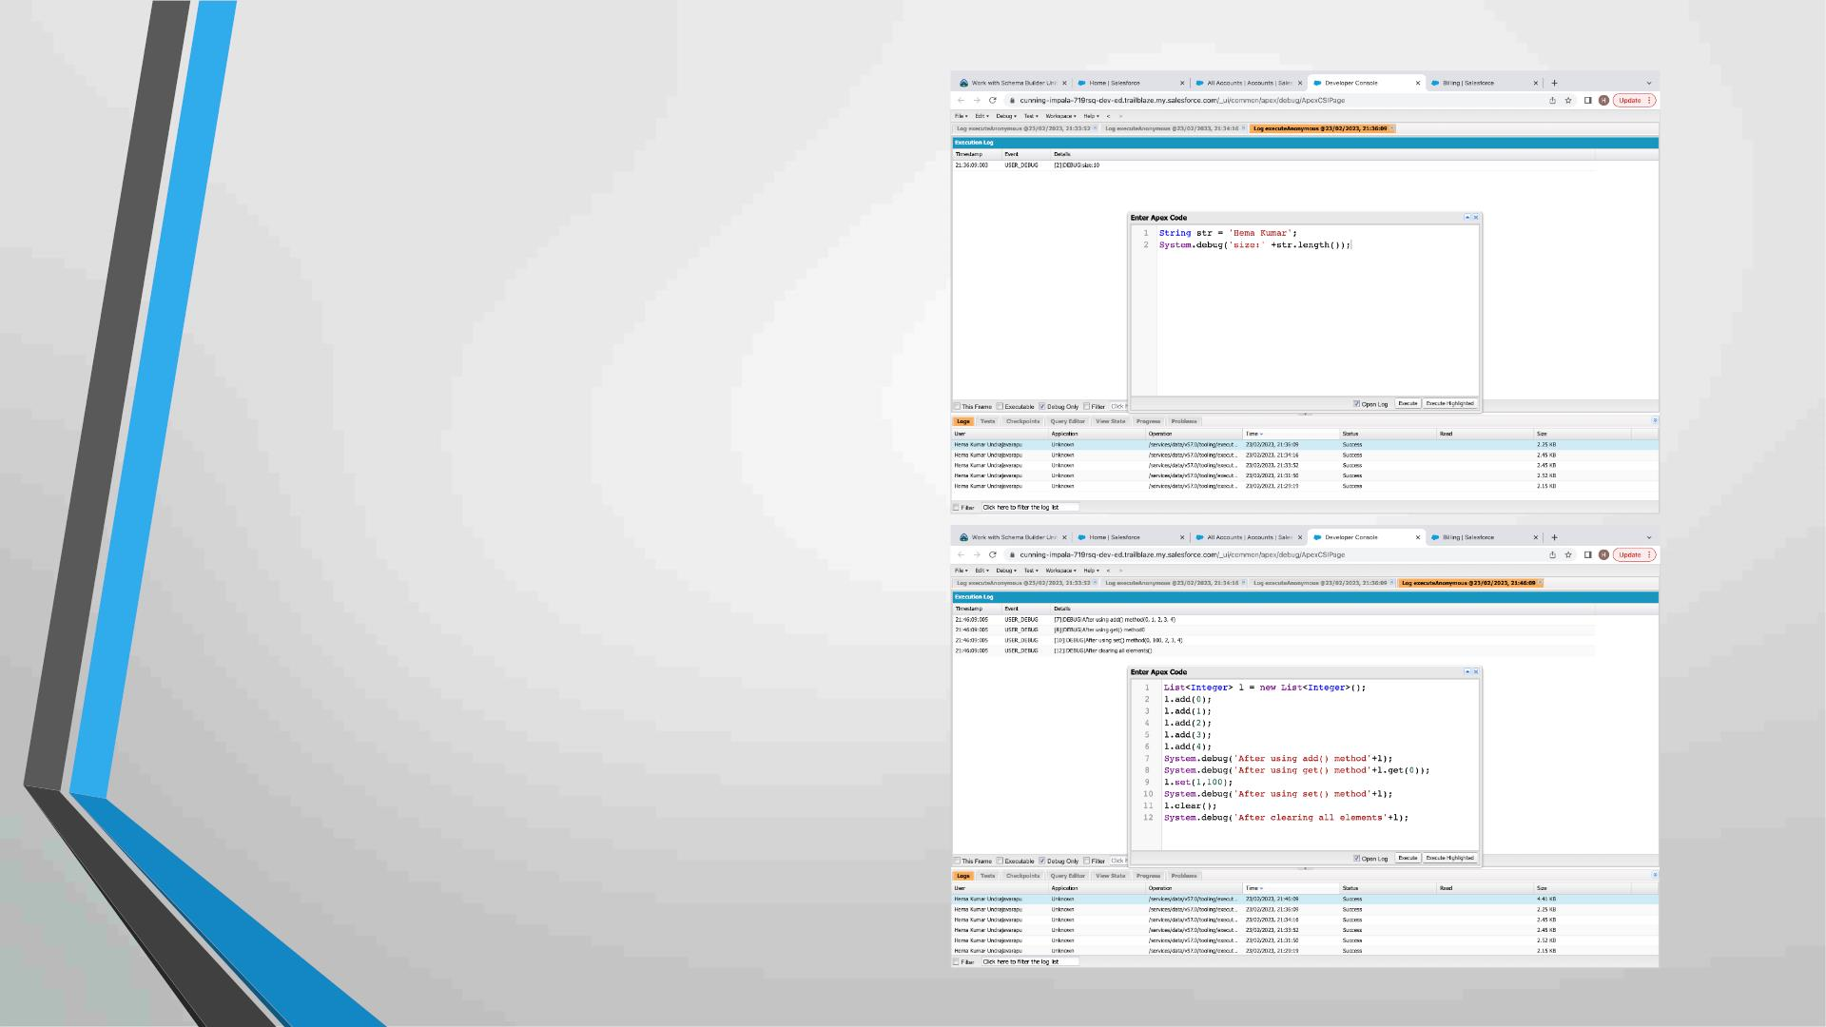
4. Define a String Variable & use
string method length() to display the
output
5. Define a List of integer and display
the output using add(), get(), set(),
clear(), methods.

Slide 37
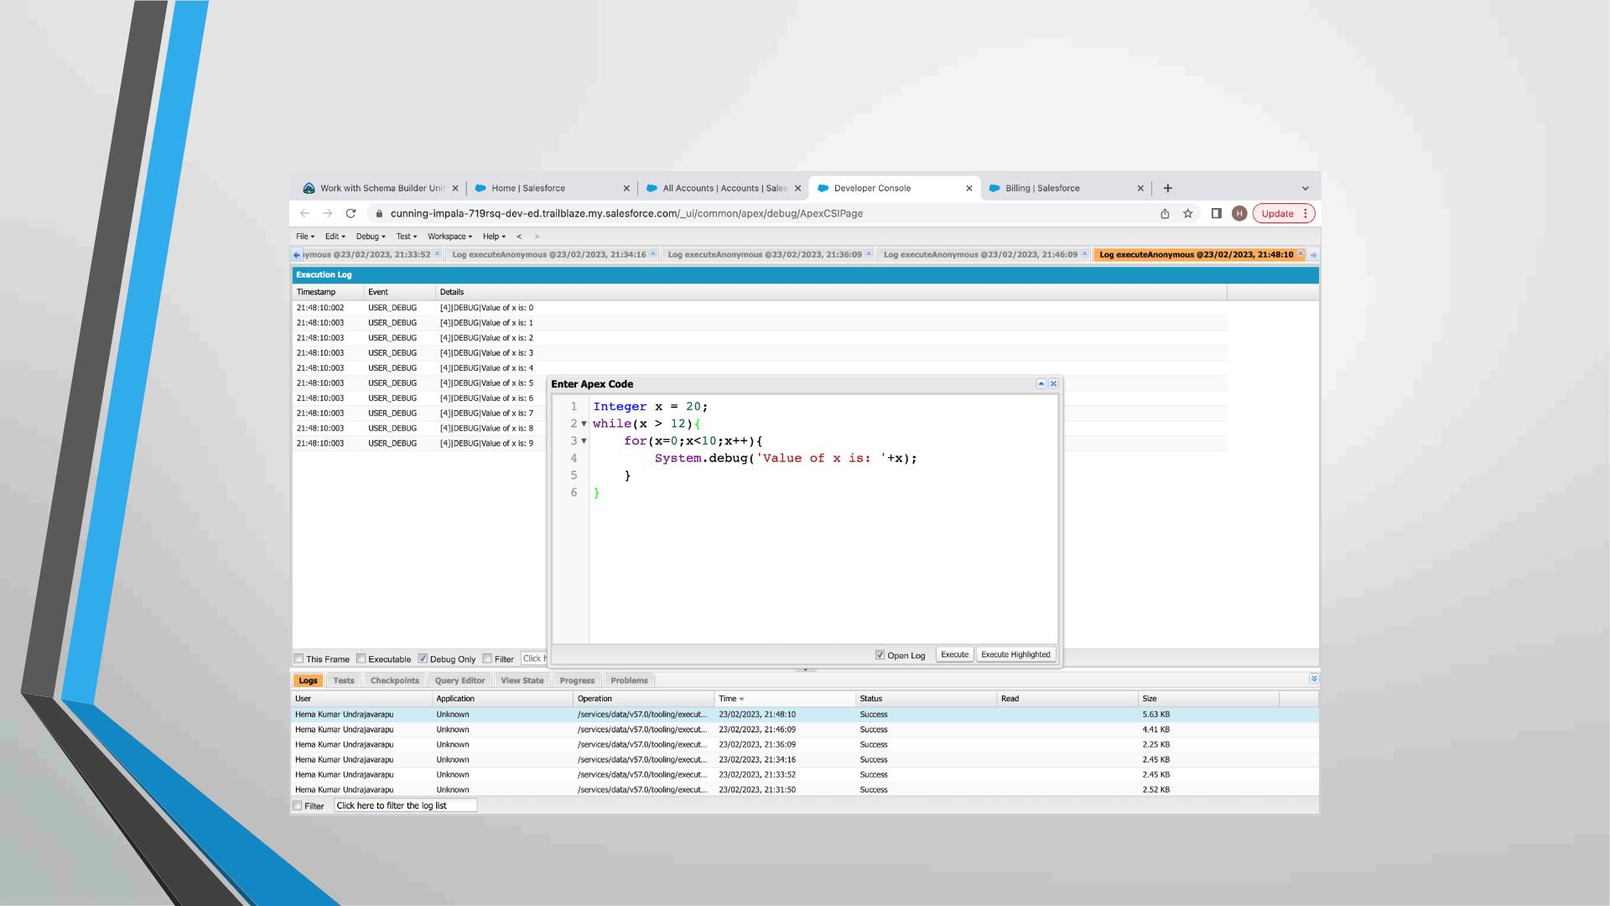
Use Execute Anonymous to define and execute the following code to
display the value of x = 0 to 9.

Slide 38
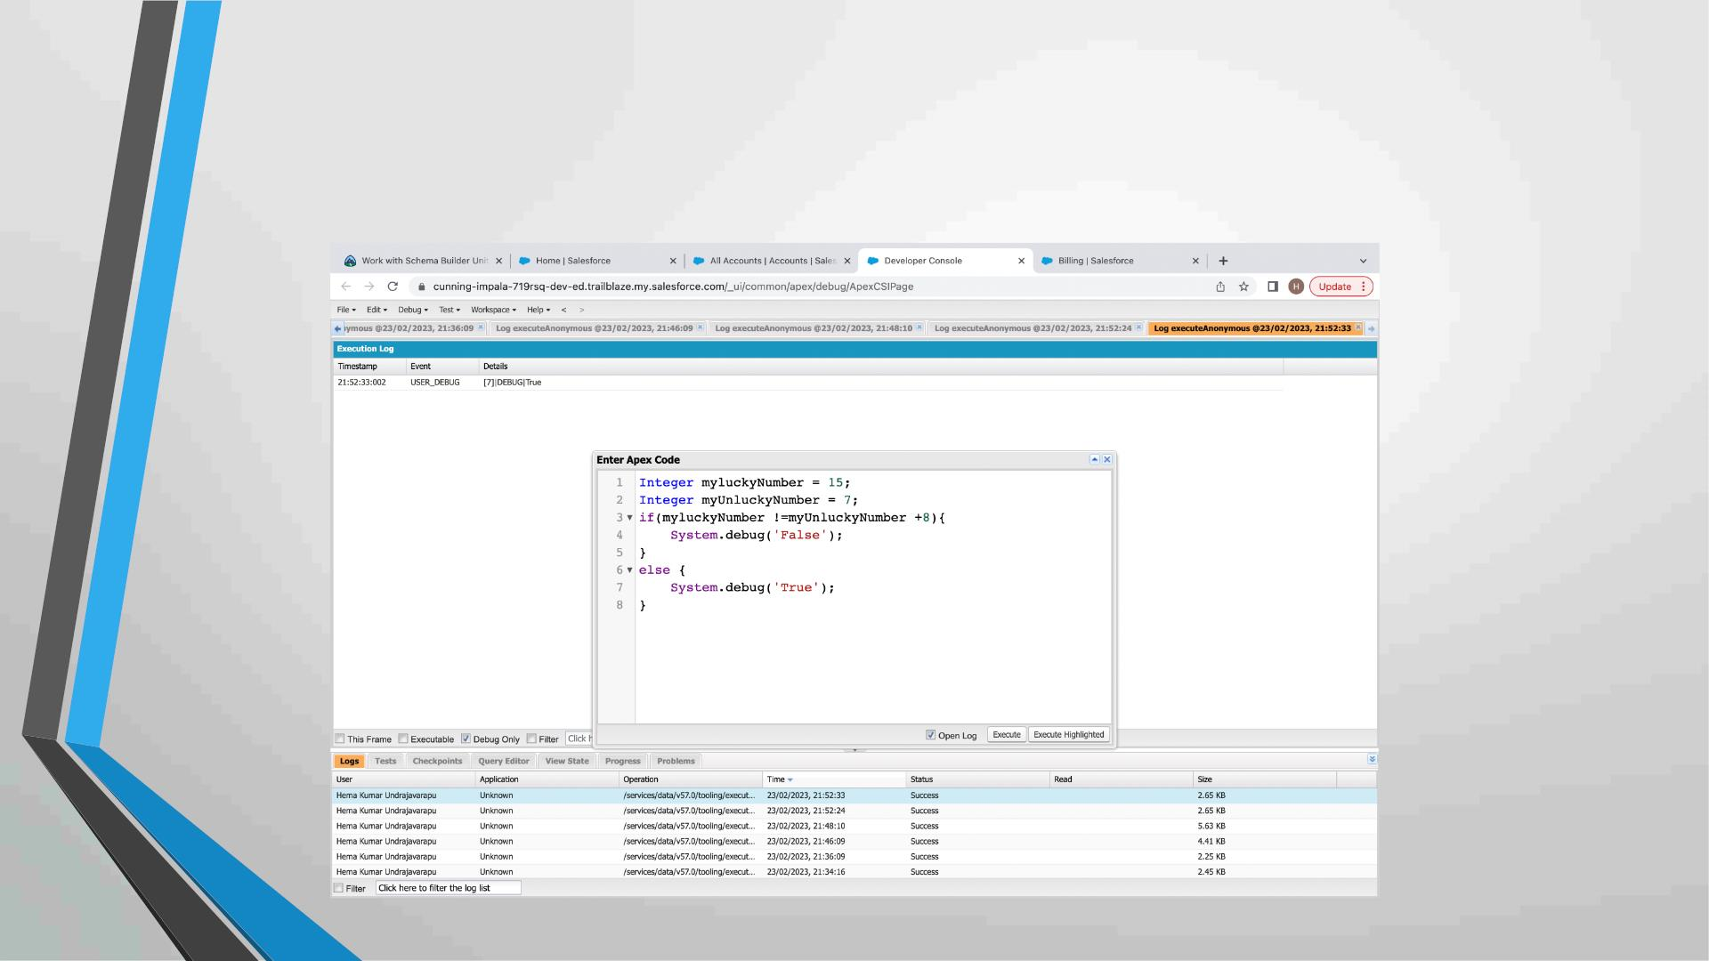
Exercise 3
Answer the following in True or False:
Integer myunlucklyNumber = 7; Integer myluckyNumber = 15;
myluckyNumber != myunlucklyNumber + 8.

Slide 39
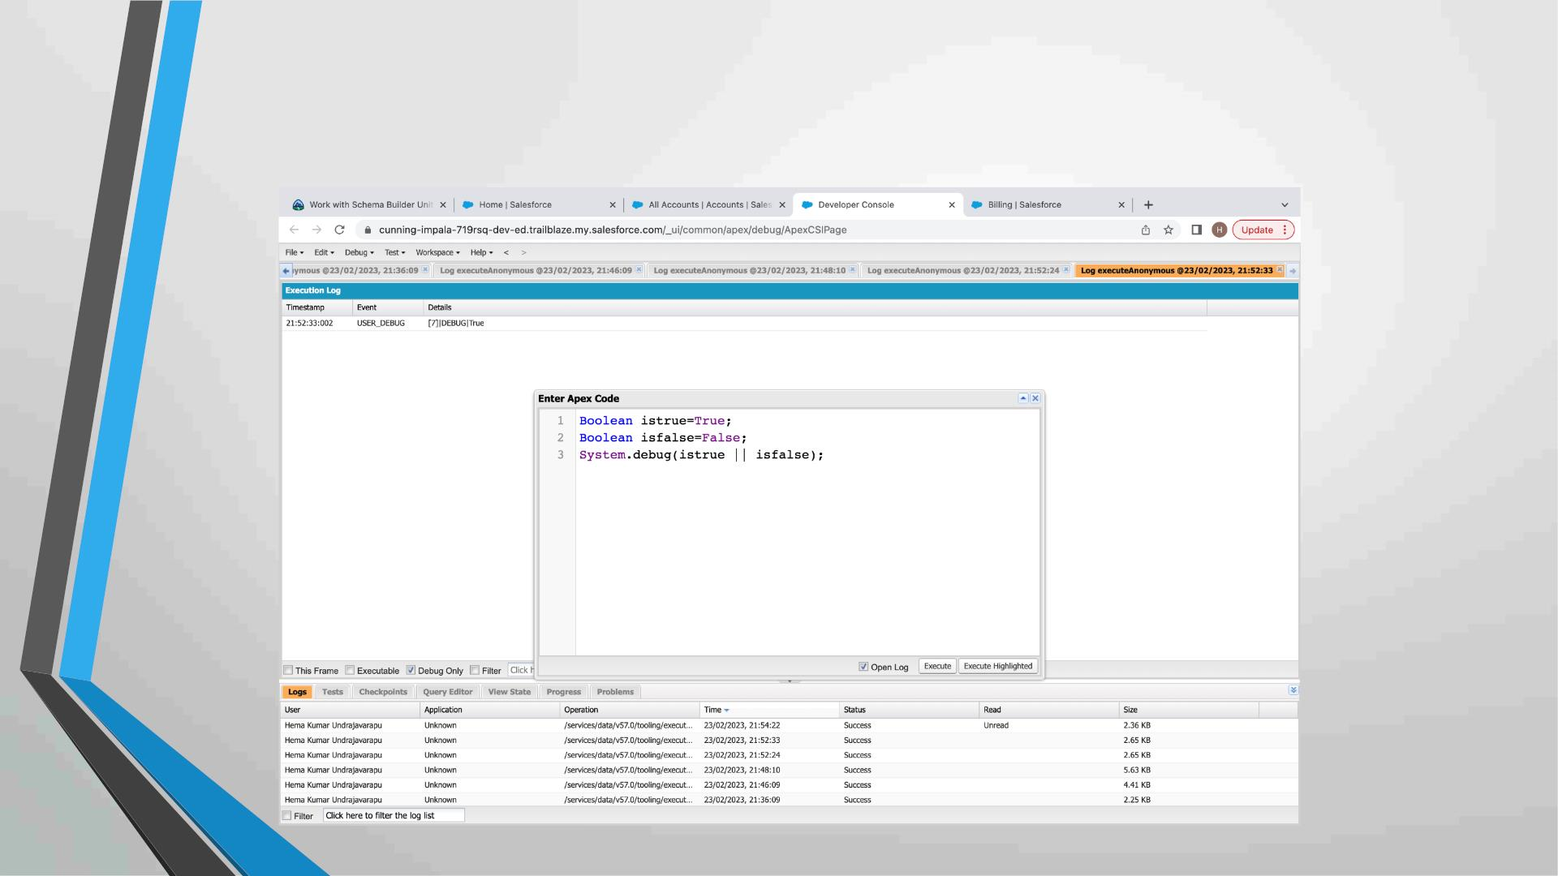
Exercise 4
Answer the following in True Or False:
Boolean isFalse = false; Boolean isTrue = true;

Slide 40
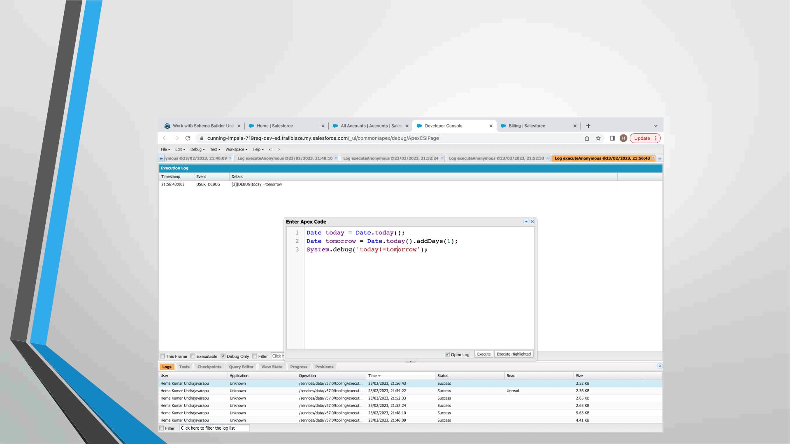
Exercise 5
Answer the following in True Or False:
Date tomorrow = Date.today().addDays(1);
Date today = Date.today();
today != tomorrow

Slide 41
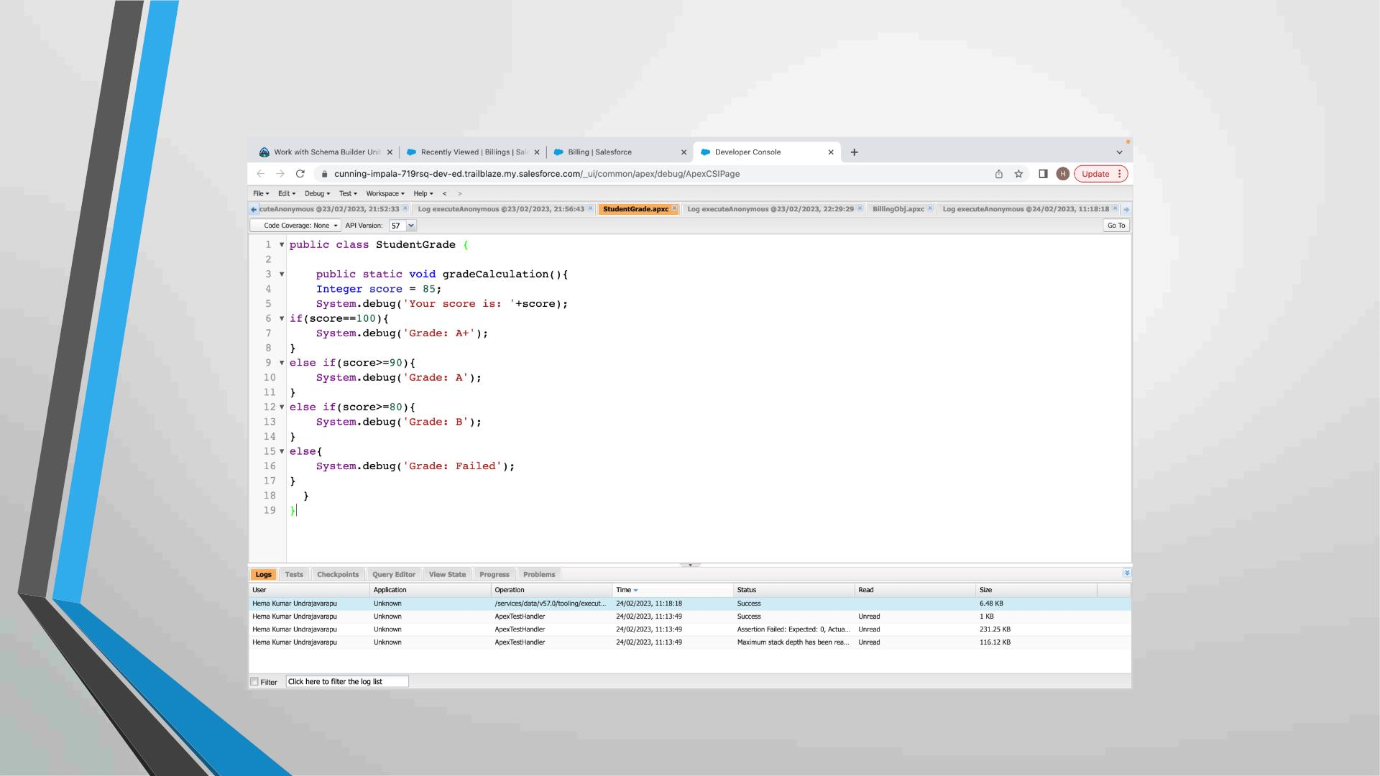
Exercise 6
Write a program and execute to demo the use of “If..else if...else”

Slide 42
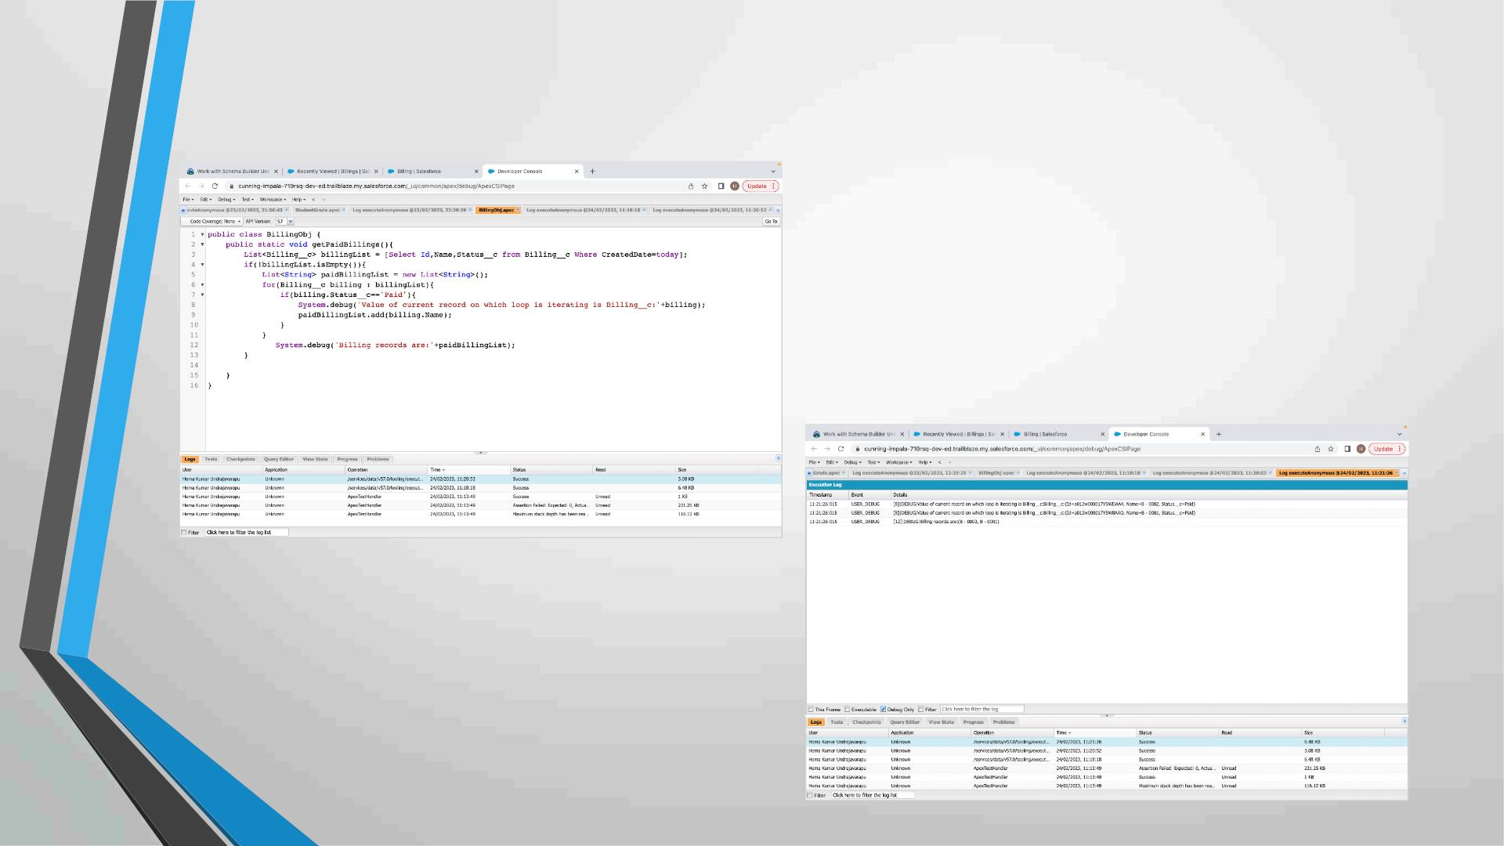
Exercise 7
Write a program to execute and demo the use of “Apex – for Loop”

Slide 43
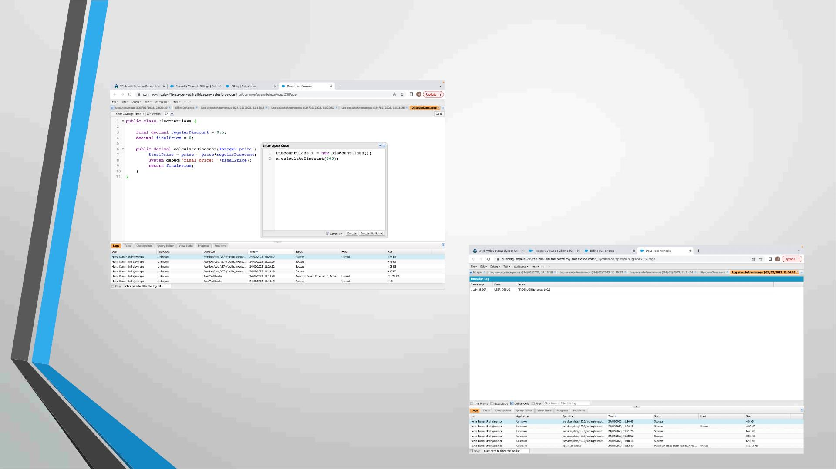
Exercise 8
Write a Class to demo the use of Constants in Apex

Slide 44
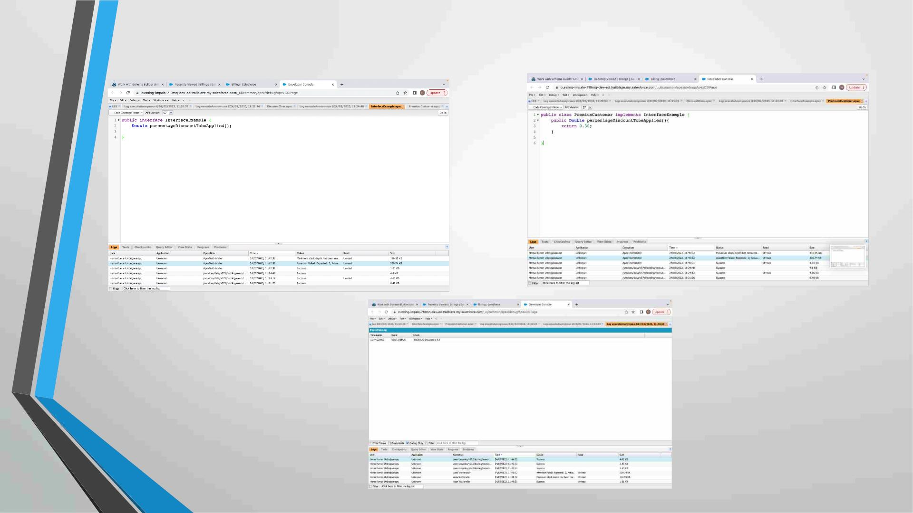
Exercise 9
Write a Class to demo the use of Interface in Apex

Slide 45
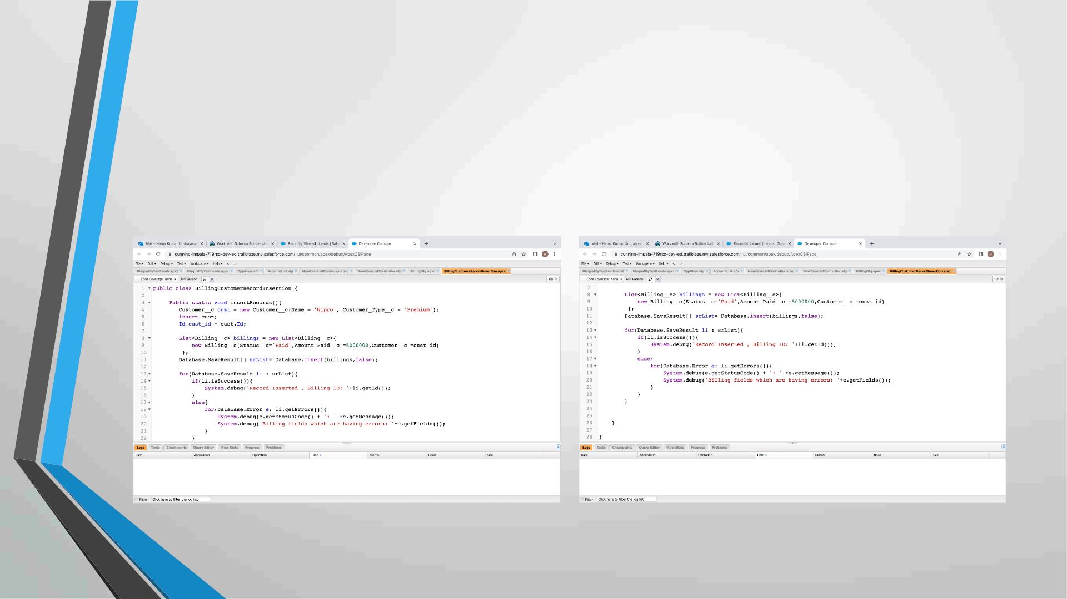
Exercise 10
Insert Billing record using Database methods
Here use record id to insert customer

Slide 46
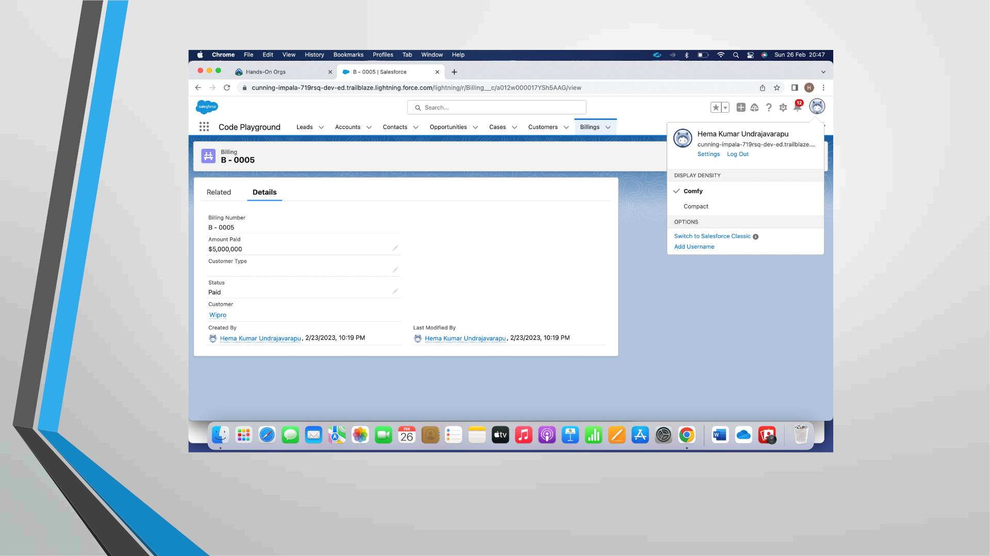

Slide 47
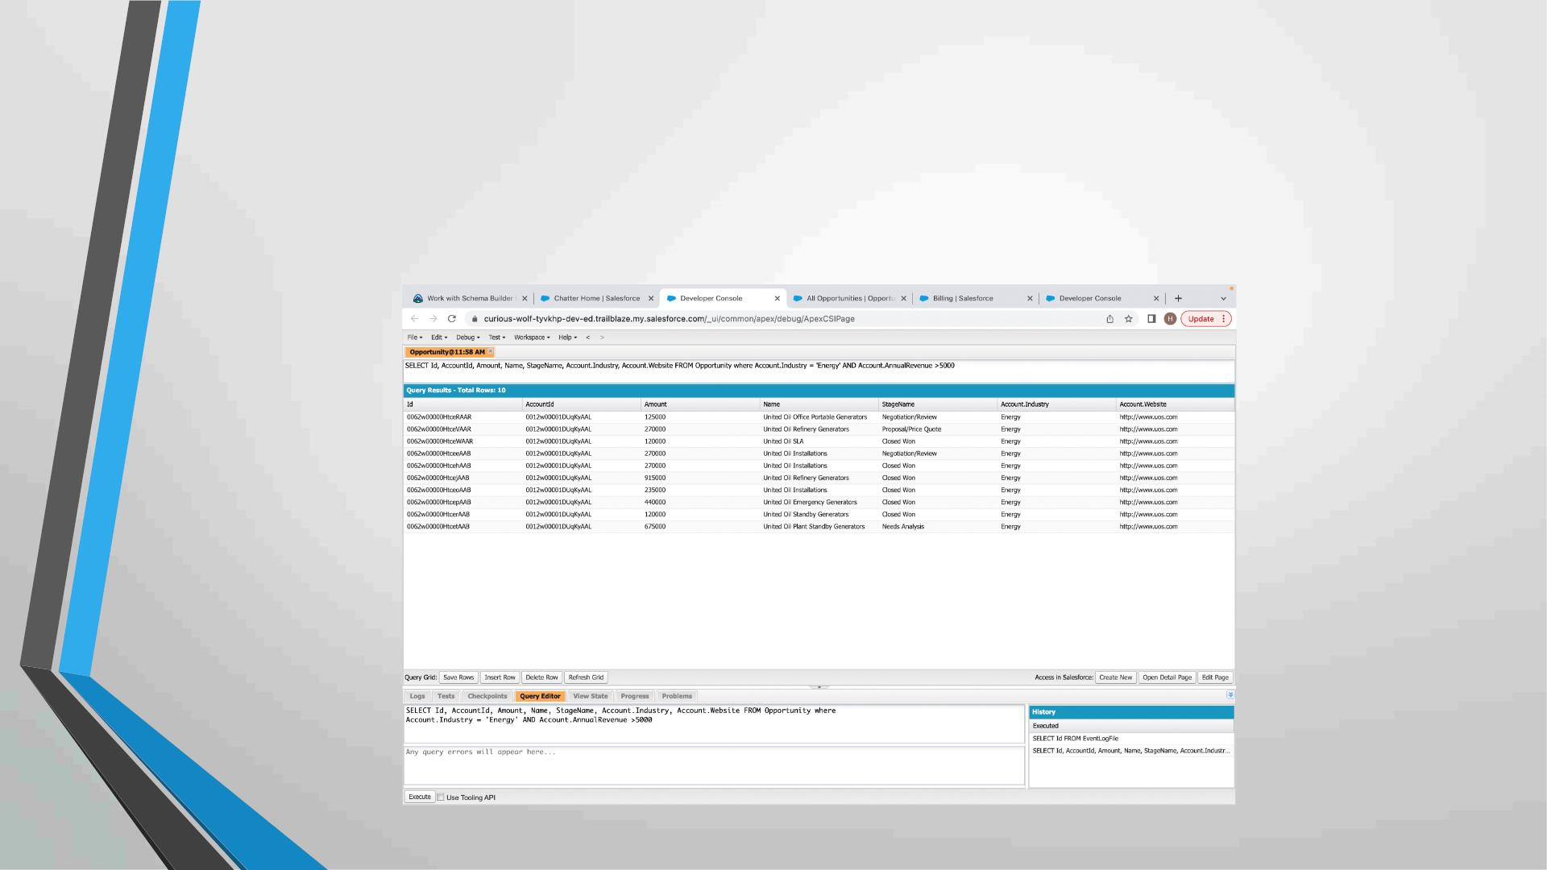
Exercise 11
Write and execute SOQL queries from Developer Console
Display ID, Amount, Stage, Account Name, Account Industry, Account Website
From Opportunity
AND “Account Annual Revenue > 5000”
Add a Where Clause “Account Industry = Energy”

Slide 48
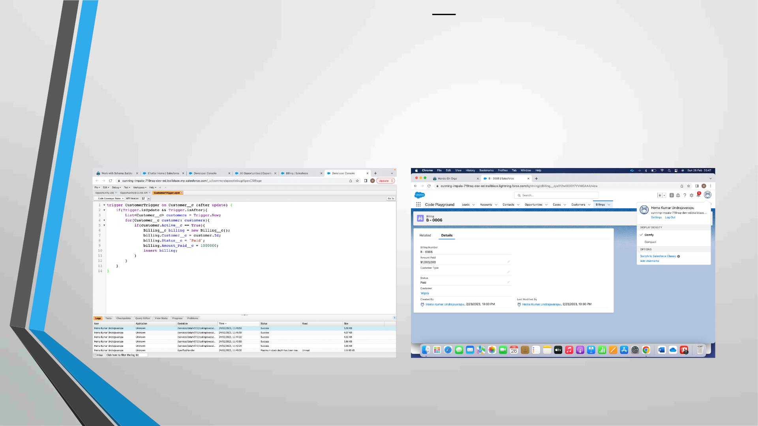
Exercise 12
Write an Apex Trigger, Name = CustomerTrigger.
Create a Billing Record when on Customer Object the 'Status' field changes
to Active from Inactive. Billing “Status” must be: Paid, Amount Paid =
15000
Perform the DML on a List.

Slide 49
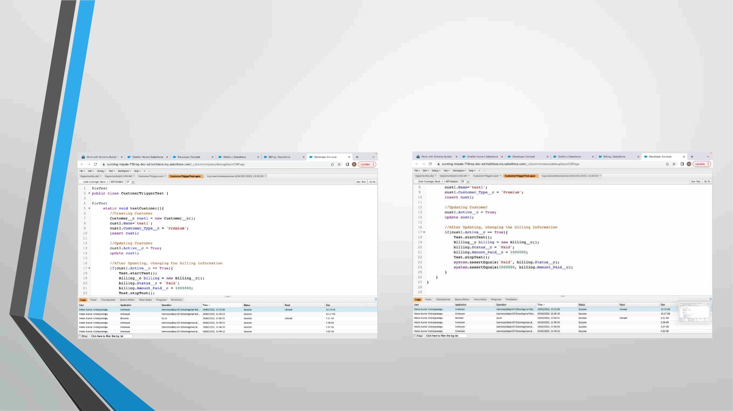
Exercise 13
Write a Test Class for CustomerTrigger.
Create the Data for the Customer custom Object
Use Test.startTest() & Test.stopTest().
Use assert statement to validate the output,
Test Class must have full code coverage.

Slide 50
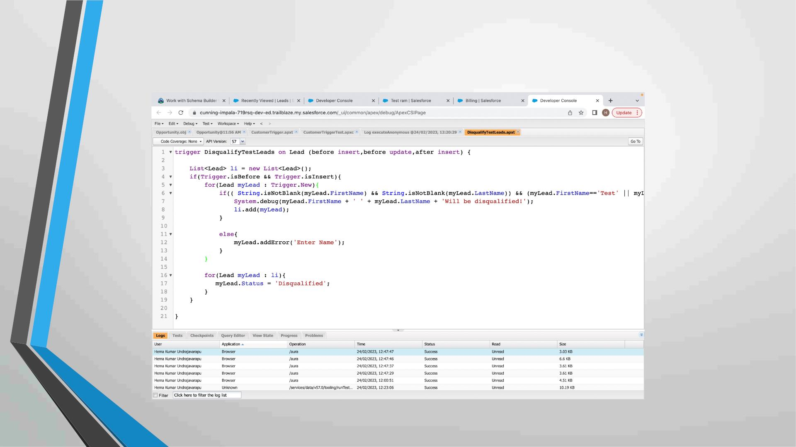
Exercise 14
ApexTrigger,Name=DisqualifyTestLeads

Slide 51
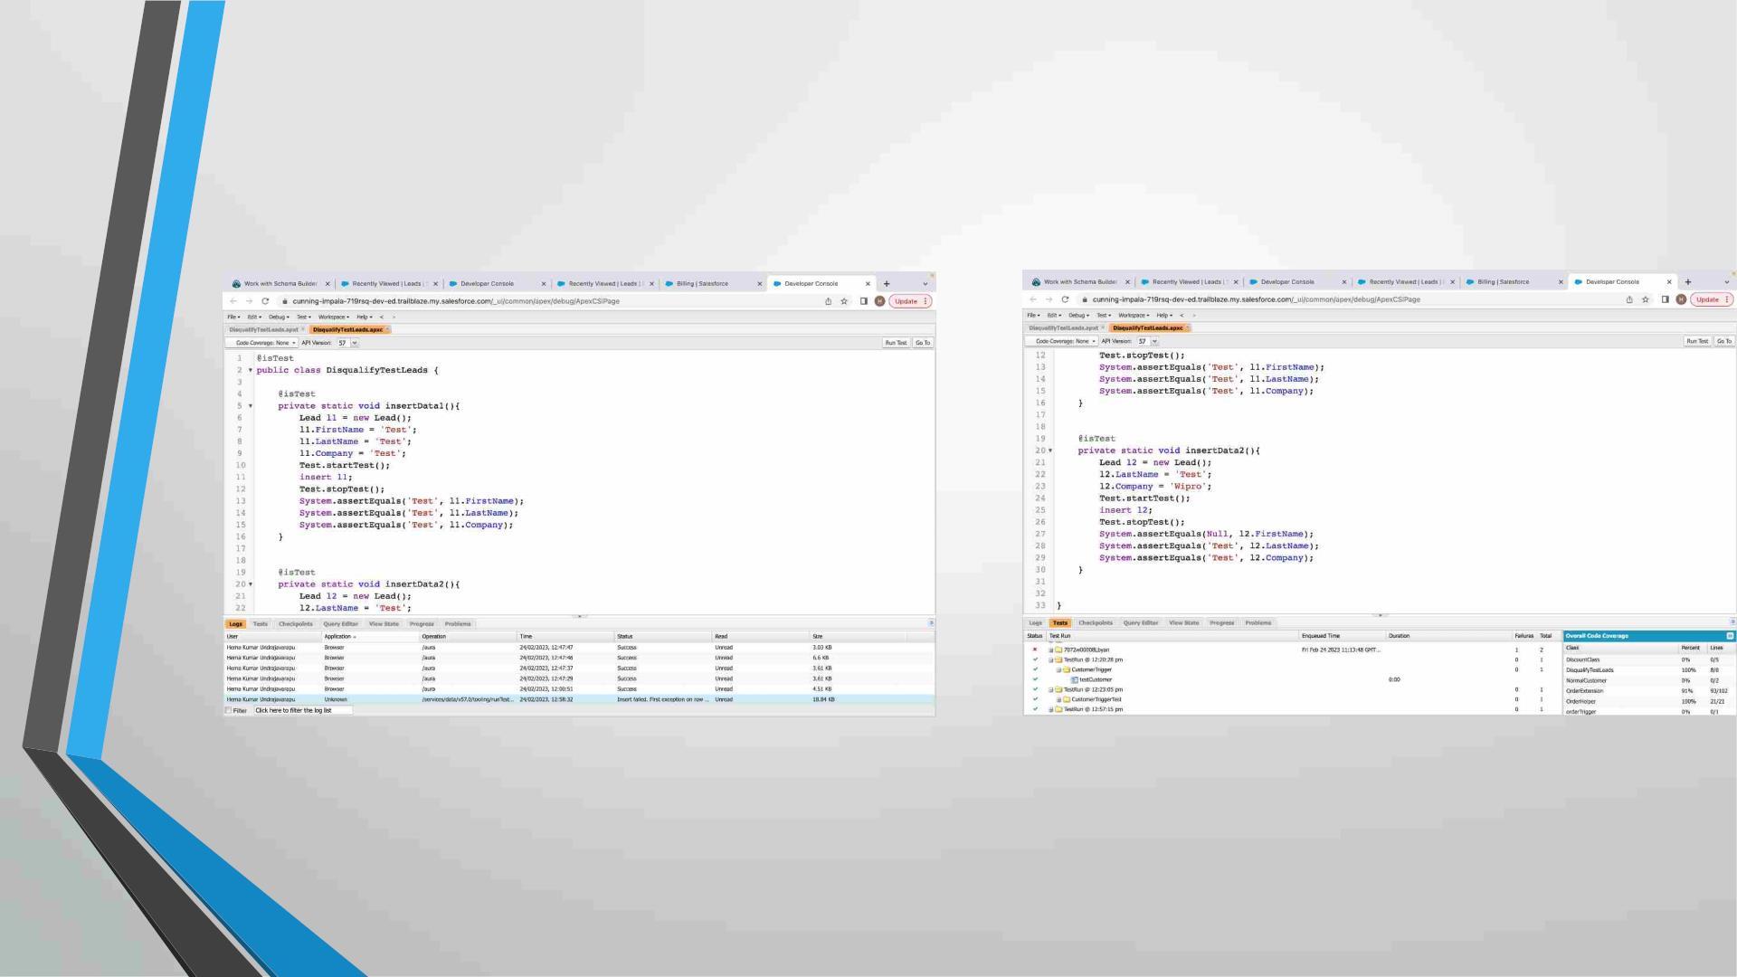
Exercise 15
Write a Test Class for DisqualifyTestLeads.

Slide 52
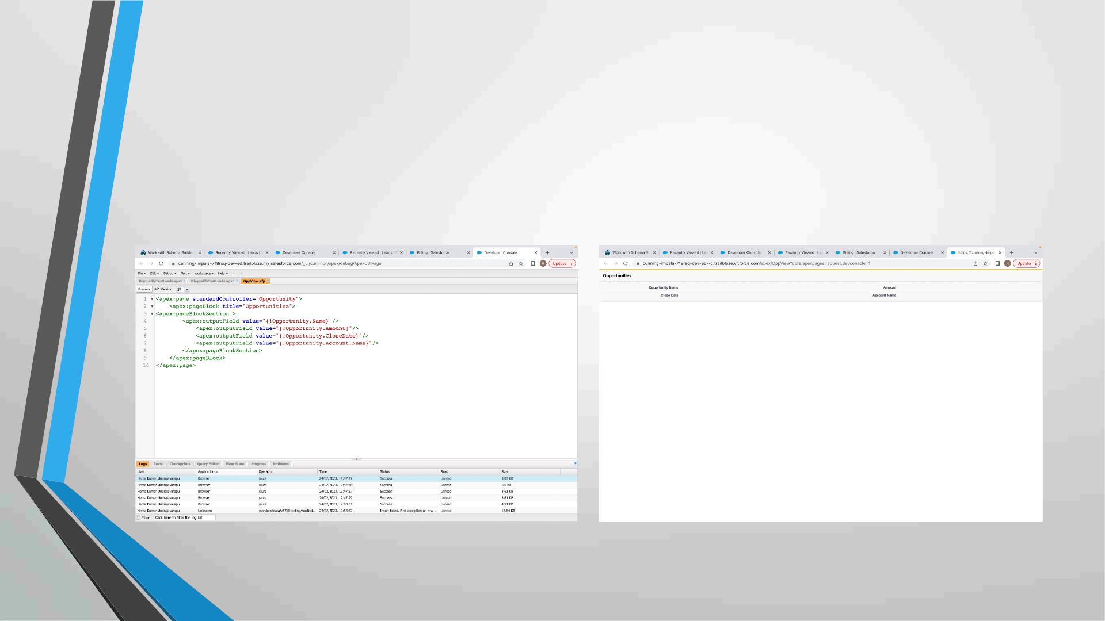
Exercise 16
Create a Visualforce page which displays Opportunity fields as output
fields.

Slide 53
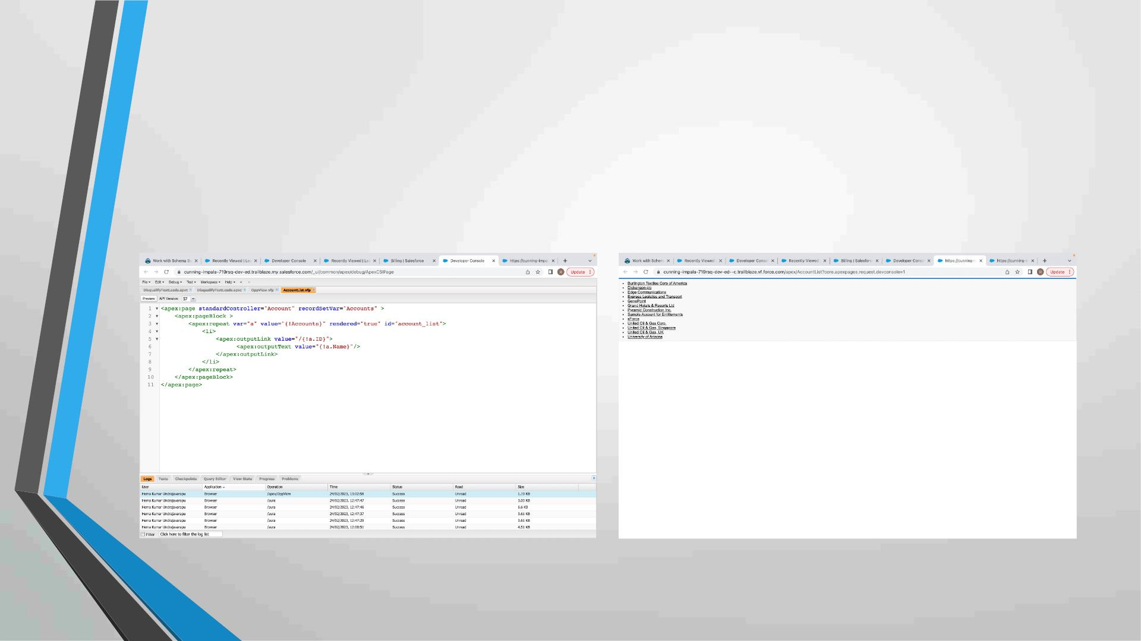
Exercise 17
Create a Visualforce page which shows a list of Accounts linked to their
record pages

Slide 54
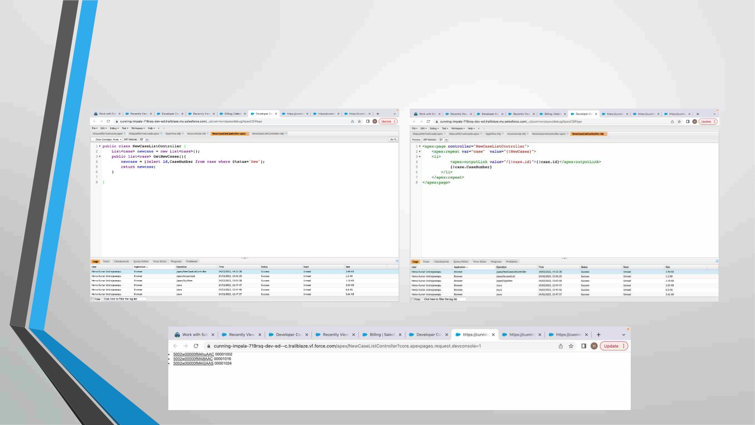
Exercise 18
Create a Visualforce page that uses a custom controller to display a list
of cases with the status of 'New'. The page must be named
NewCaseList.

